Slide 1
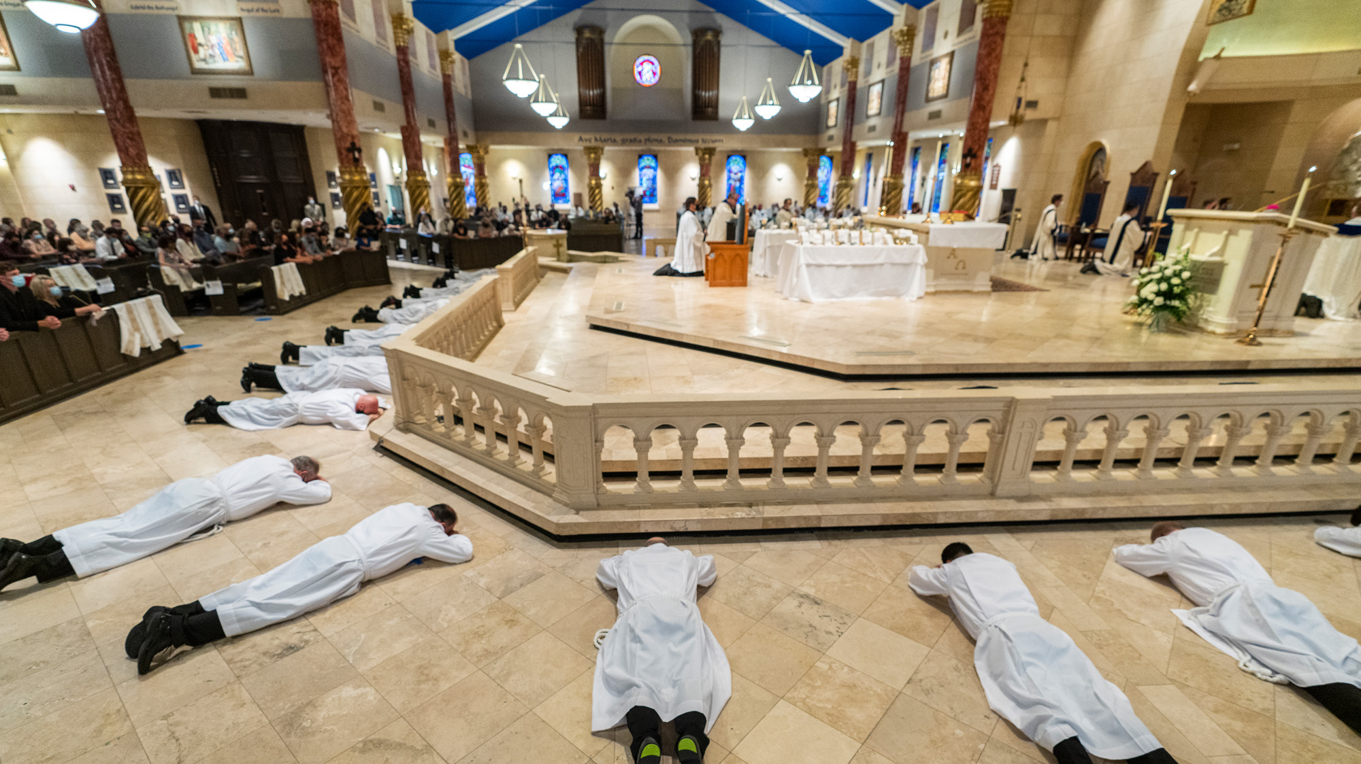
Catholic Diocese of Fort Worth – Statistics and Diaconal Call

Slide 2
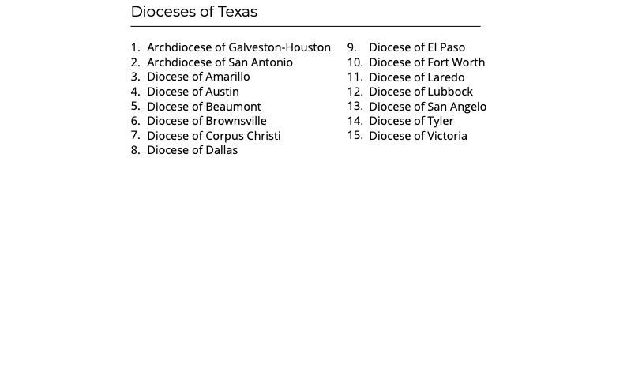
The 15 Dioceses of Texas

Slide 3
The Catholic Diocese of Ft. Worth
Pope Paul VI created the Diocese of Ft. Worth on August 9, 1969
Diocese encompasses
  23,950 square miles
  28 counties
  1,200,000 Catholics
  15 Deaneries
  91 Parishes
  19 Schools
Bishops over time
  Most Rev. John J. Cassata
  Most Rev. Joseph P. Delaney
  Most Rev. Kevin W. Vann
  Most Rev. Michael F. Olson

Slide 4
The Catholic Diocese of Ft. Worth
137 Priests (Total)
119 Priests (Active)
47 Diocesan Priests (active)
58 Order Priests
18 Retired Priests
15 Diocesan
3 Diocesan (not incardinated)
24 Seminarians
5 Personal Ordinariate
2 Eastern Rites
7 Diocesan Priests (not incardinated)

Slide 5
The Catholic Diocese of Ft. Worth
137 Deacons (Total)
103 Active
20 Deacons (not incardinated)
19 Aspirants/Candidates
25 Retired
9 Out of the diocese

Slide 6
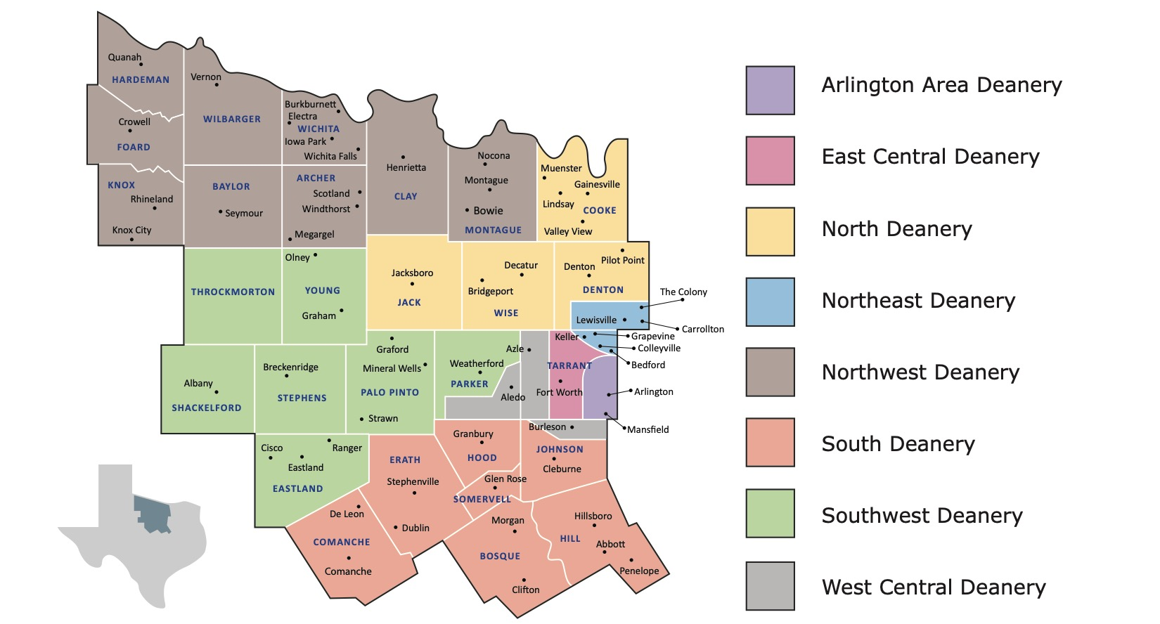

Slide 7
Deacons by Deanery
Arlington
  8 Parishes
  6 Deacons under age 75
  4 Men in formation program
East Central
  11 Parishes
  8 Deacons under age 75
  4 Men in formation program
West
  10 Parishes
  9 Deacons under age 75
  7 Men in formation program

Slide 8
Deacons by Deanery
Northeast
  9 Parishes
  13 Deacons under age 75
  9 Men in formation program
North
  11 Parishes
  14 Deacons under age 75
  5 Men in formation program
South
  12 Parishes
  4 Deacons under age 75
  1 Men in formation program

Slide 9
Deacons by Deanery
Northwest
  20 Parishes and missions
  2 Deacons under age 75
  7 Men in formation program
Southwest
  11 Parishes
  4 Deacons under age 75
  2 Men in formation program

Slide 10
Deacons by Age Group
17 Deacons 75 years old and older
62 Deacons under age 75 years old
  17 Deacons 70-74 years old
  15 Deacons 65-69 years old
  20 Deacons 60-64 years old
  10 Deacons <60 years old

Slide 11
Deacon Forecast
3 Candidates in 2024 Cohort
8 Candidates in 2025 Cohort
8 Aspirants in 2027 Cohort
12 Applicants in propaedeutic year - 2029 Cohort

Slide 12
Deacons are Called From All Walks of Life
Origin
  North America
  Central America
  South America
  Vietnam
  Tonga
  Africa
  Korea
  Philippines
  Central Europe

Slide 13
Deacons are Called From All Walks of Life
Education
  High School or GED
  Some College
  Undergraduate
  Graduate
  Continuing Education

Slide 14
Deacons are Called From All Walks of Life
Occupation
  Technology
  Construction
  Engineering
  Services
  Automotive
  Medical
  Insurance
  Sales/Marketing
  Education
  Non-profits
  Self-employed
  Retired

Slide 15
What is the Catholic Diocese of Fort Worth Looking for in Men Interested in the Diaconate?
National Directory for the Formation, Ministry, and Life of Permanent Deacons in the United States (The Diaconal Call)
“From the experience of the restored diaconate in the United States, certain behavioral patterns [human qualities] have been discerned among exemplary deacons…
A natural inclination of service to the Christian community and to all in need;
Psychological integrity;
A capacity for dialogue, which implies a sense of docility and openness;
The ability to share one’s faith yet listen respectfully to other points of view;

Slide 16
What is the Catholic Diocese of Fort Worth Looking for in Men Interested in the Diaconate?
The capacity to listen carefully and without prejudices – respecting people in the context of their religion, race, gender, ethnicity, and culture;
Good communication skills;
A sense of responsibility that includes the fulfilling of one’s word and completing one’s work;
Self-directed and collaborative accountability;
Balanced and prudent judgment;
Generosity and service; and
The ability to lead, motivate, facilitate, and animate others into appropriate action and service” (ND, 174)

Slide 17
What is the Catholic Diocese of Fort Worth Looking for in Men Interested in the Diaconate?
“The profile is completed with certain spiritual and evangelical qualities. Among these are:
A sound faith;
Good Christian reputation;
Active involvement in the Church’s apostolate;
Personal integrity, maturity, and holiness;
Regular participation in the Church’s sacramental life;
Evidence of recognized, ongoing commitment to the Church’s life and service;
Participation in faith enrichment opportunities (e.g., retreats, days of recollection, adult education programming);

Slide 18
What is the Catholic Diocese of Fort Worth Looking for in Men Interested in the Diaconate?
A positive and stable marriage, if married, or a mature celibate state of life, if single;
Active membership in a Christian community;
Capacity for obedience and fraternal communion; and
A deep spirituality and prayer life.
The presence of these qualities, experienced in kindness and humility, may demonstrate a call to the Order of Deacons.” (ND, 175)

Slide 19

What is the Catholic Diocese of Fort Worth Looking for in Men Interested in the Diaconate?
We are looking for ordinary men that want to make extraordinary differences in peoples’ lives.

