Slide 1

Diaconate Formation
ADMISSIONS PROCESS AND
FORMATION - OVERVIEW

Slide 2
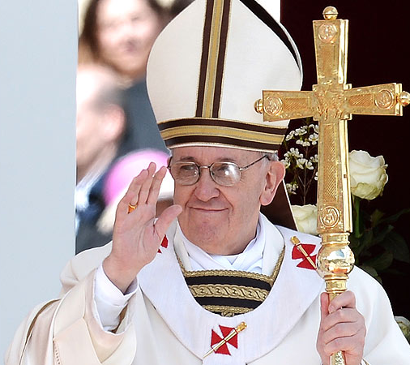
Pope Francis, The Joy of the Gospel
Ordination of Deacons – In Order to Serve
“I repeat for the entire Church what I have often said to the priests and laity of Buenos Aires: I prefer a Church which is bruised, hurting and dirty because it has been out on the streets, rather than a Church which is unhealthy from being confined and from clinging to its own security…

Slide 3
Pope Francis, The Joy of the Gospel
“If something should rightly disturb us and trouble our consciences, it is the fact that so many of our brothers and sisters are living without the strength, light and consolation born of friendship with Jesus Christ, without a community of faith to support them, without meaning and a goal in life.” (Evangelii Gaudium, 49)

Slide 4
The Formation Process
Christ the Servant
Charity
Liturgy
Word
The deacon’s ministry of service is linked with the missionary dimension of the Church embracing through the ministry of the Word, the liturgy and charity

Slide 5

Background and Perspective
Formation is not…
  Just educational classes…
  Teaching how to do…
Formation is a journey of faith
  It is holistic
  It is transformative
  Some will change paths
  Listening is key

Slide 6

Stages in the Formation Process
INITIAL INQUIRY
PROPAEDEUTIC PERIOD (1 YEAR)
ASPIRANT STAGE (2 YEARS)
CANDIDATE STAGE (3 YEARS)
  Institution to Ministry of Lector
  Institution to Ministry of Acolyte
  Petition for Holy Orders
  Canonical retreat
ORDINATION TO THE DIACONATE
POST-ORDINATION FORMATION (5 YEARS)

Slide 7
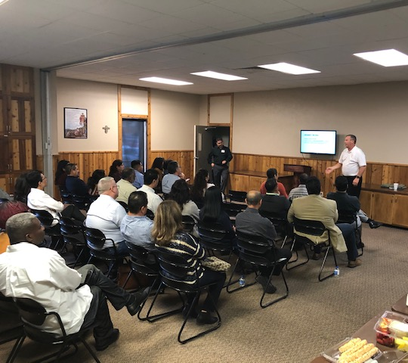
Application Process for Aspirancy
The overall application process includes
  1. Attendance to Information Session
  2. Participation in propaedeutic period (1 year – September to May)
  Submission of Application
  Marriage Assessment
  Psychological Evaluation
  Personality Inventory
  Formal interview with Coordinator of Admissions
  7. Letter of Admission to Formation

Slide 8

Aspirant stage
It is propaedeutic in the sense that it is primarily a time to discern the capability and readiness of an aspirant to be nominated to the diocesan Bishop for acceptance as a candidate (National Directory, 190)
The goal is to enable the aspirant to demonstrate the possibility of a diaconal vocation and an appropriate level of readiness for eventual selection into candidate Formation. (National Directory, 192)

Slide 9
The Components (ND, 195)
Is intended to provide a time for…
  1. Introduction to the study of theology
  2. Deeper knowledge of the spirituality and ministry of the deacon
  3. More attentive discernment of a diaconal vocation

Slide 10
The Components (ND, 195)
  4. Form a community
  5. Ensure regular participation in spiritual direction
  6. Introduction to pastoral ministries of the diocese
  7. Assist family in their support of your formation

Slide 11
formation calendar
The Aspirant community
  Intellectual Formation ONLINE
  Monthly In-person Meetings (typically Saturday)
  Meetings include class, small group meetings, reflection, prayer

Slide 12
Formation: Human and spiritual
Human Dimension
Small formation groups
Led by a Deacon Mentor
Spiritual Dimension
Sacramental life
Spiritual direction with priest
Liturgy of the Hours
Retreats

Slide 13
Formation: Intellectual and pastoral
Intellectual Dimension (ONLINE)
History, Theology and Ministry of the Diaconate
Catholic Spiritual Tradition
Catechism of the Catholic Church
Philosophy for Theology
Pastoral Dimension
Practicum in the parish
Pastoral courses
Diaconal Vocation and Ministry
Ongoing vocational discernment

Slide 14
Diaconate Formation Team
Oversee the formation and evaluation process
Deacon Mentor Evaluations
Peer Evaluations
Pastor Supervisor Evaluation
Self-Evaluation
Admission to Candidacy
Meeting with Admissions Committee
Acceptance at the discretion of the Bishop

Slide 15
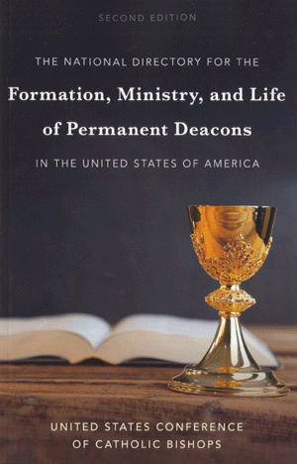
Overview of Formation
National Directory
  Normative Guide
  Sets National Objectives

Slide 16
Focus of Diaconal Formation
4 Dimensions
  Human
  Spiritual
  Intellectual
  Pastoral
Vocational Discernment and Ministry
Ministries
Word
Liturgy
Charity

Slide 17
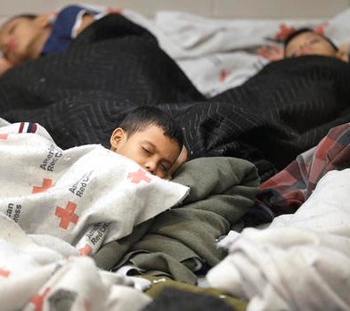
Charity
Church’s commitment to the preferential option for the poor and vulnerable
Catholic Social Teaching

Slide 18
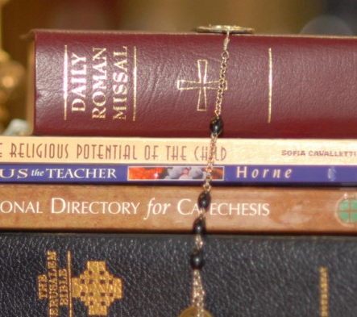
Word
Teachers of the Word of God
Evangelization
Catechesis

Slide 19
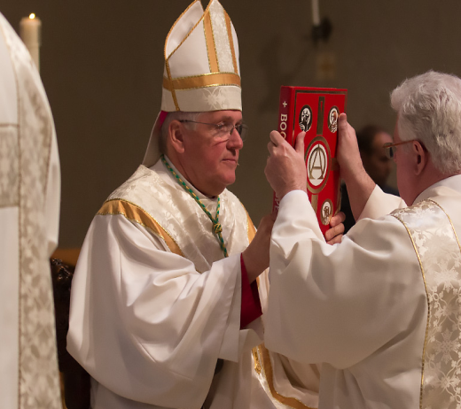
Liturgy
Herald of the Gospel
Proclamation
Homiletics
Sacraments

Slide 20
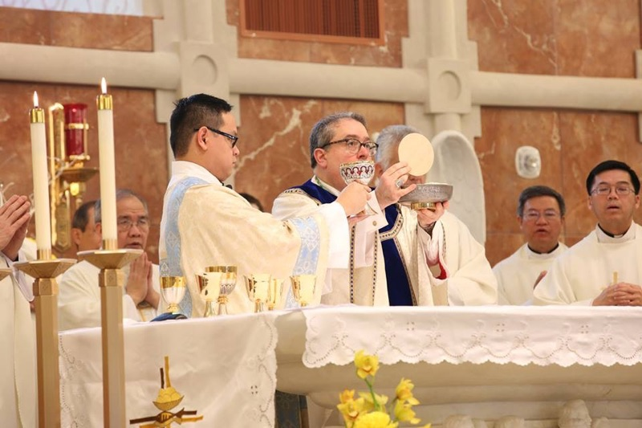
Formation for the Diaconate
The responsibility of formation
  Bishop
  Director of Formation
  Pastor Supervisor
  Aspirant/Candidate
  Wife and Family

Slide 21
Candidate stage
Begins with the Rite of Admission to Candidacy for Holy Orders
A retreat precedes the Rite of Admission to Candidacy
Requires the active participation of the candidate
Takes place in several environments
  Formation gatherings
  Parish and community ministry
  Retreats and days of recollection
  Meetings with pastor, mentor, spiritual director
  In the daily family and work life of candidate

Slide 22
Candidacy stage
“The candidate stage of initial formation is the occasion to confirm a man’s diaconal vocation and prepare for ordination. The candidate himself assumes the primary responsibility for his discernment and development.” (National Directory, 213)

Slide 23
intellectual dimension
Sacred Scripture
  Interpretation
  Old Testament
  New Testament
Moral Theology
  Fundamental Moral
  Bioethics
  Social Doctrine
  Marriage and Human Sexuality
Systematic Theology
  Trinity
  Christ
  Church
  Sacraments
  Liturgy
  Mariology
Historical Theology
  History of the Church
  Patristics
  Catholic Church in America

Slide 24
Retreats and Days of Recollection
Retreats occur annually
  Throughout Aspirancy/Candidacy
  Prior to Admission to Candidacy
  During final year of formation
Days of Recollection
  Prior to Institution to Ministry of Reader
  Prior to Institution to Ministry of Acolyte
Pre-Ordination retreat
  For a full week
  Silent retreat

Slide 25
Evaluations
Evaluations are intended to assess work of:
  Aspirant/Candidate formation
  Faculty effectiveness
  The overall program
The evaluation process is intended to be open, pastoral and collaborative
Based on the Basic Standards for Readiness (National Directory)

Slide 26
Evaluations
Candidates are evaluated each year
Who evaluates?
  Deacon Mentor
  Pastor
  Faculty
  Peers
  Other formation team members
The overall evaluation of a candidate’s formation is drawn from the all evaluations (Director’s responsibility)

Slide 27
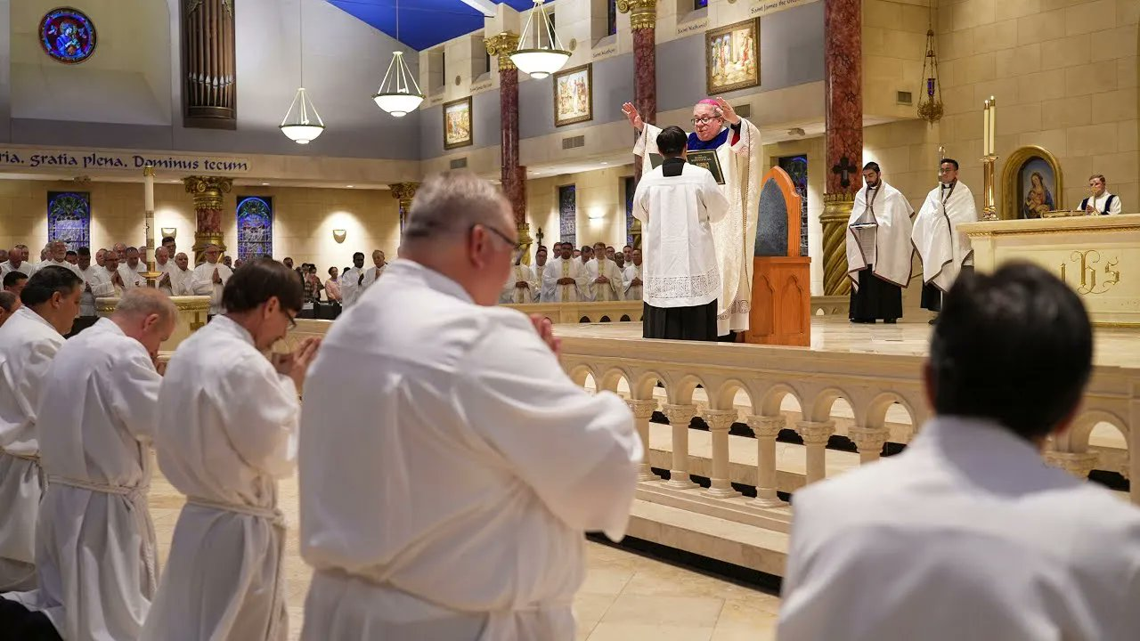
Ordination to the diaconate

