Slide 1

Diaconate Formation
Celibacy and Holy Matrimony

Slide 2

Celibacy
CCC1579: All the ordained ministers of the Latin Church, with the exception of permanent deacons, are normally chosen from among men of faith who live a celibate life and who intend to remain celibate “for the sake of the kingdom of heaven.”
Called to consecrate themselves with undivided heart to the Lord and to “the affairs of the Lord,” they give themselves entirely to God and to men. Celibacy is a sign of this new life to the service of which the Church’s minister is consecrated; accepted with a joyous heart celibacy radiantly proclaims the Reign of God.

Slide 3
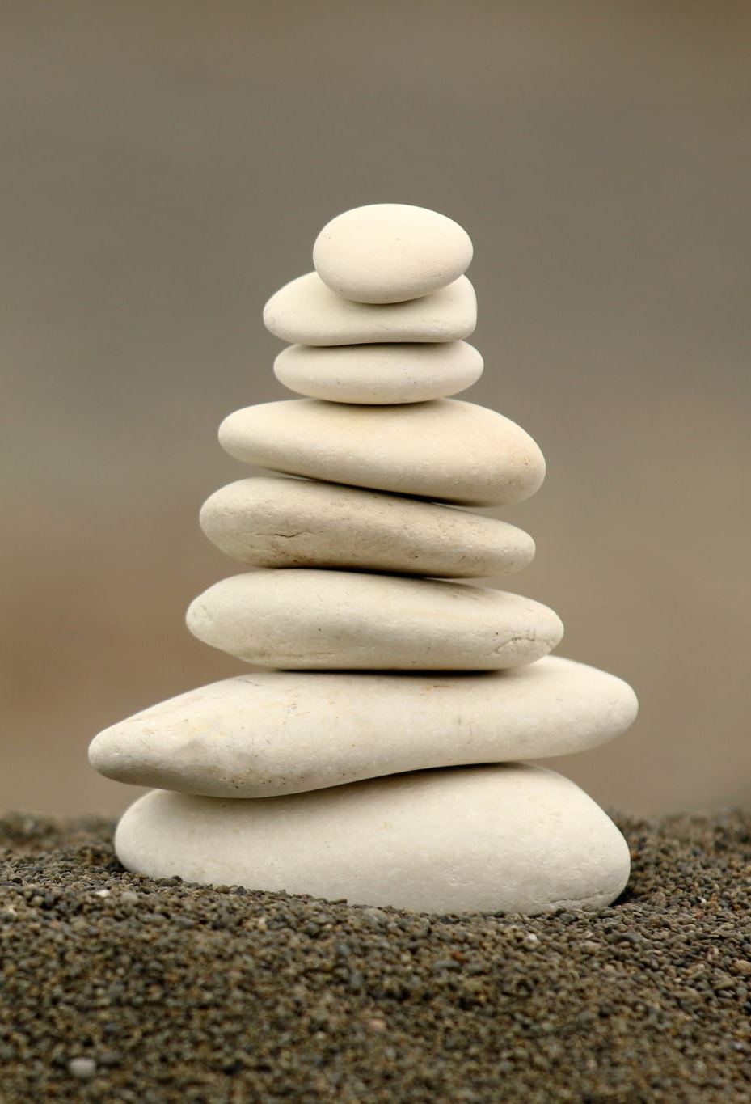
Celibacy
Defined as:
The state or condition of those who have chosen to remain unmarried for the sake of the kingdom of heaven in order to give themselves entirely to God and to the service of his people.
CCC 1580: In the Eastern Churches while bishops are chosen solely from among celibates, married men can be ordained as deacons and priests. Priestly celibacy is held in great honor and many priests have freely chosen it of the sake of the Kingdom of God. In the East as in the West a man who has already received the sacrament of Holy Orders can no longer marry.

Slide 4
Celibacy affects every Deacon
National Directory 78: In one way or another, celibacy affects every deacon, married or unmarried. Understanding the nature of celibacy—its value and its practice—are essential to the married deacon. Not only does this understanding strengthen and nurture his own commitment to marital chastity, but it also helps to prepare him for the possibility of living celibate chastity should his wife predecease him.
Tragically, some deacons who were married at the time of ordination only begin to face the issues involved with celibacy upon the death of their wives. As difficult as this process is, all deacons need to appreciate the impact celibacy can have on their lives and ministry.

Slide 5
Clerical Celibacy
(Historical Development)
Clerical celibacy was derived from oral tradition and Holy Scripture
Council of Elvira, 303 A.D. contains the first regulation concerning celibacy…. “It has seemed good absolutely to forbid the bishops, the priests, and the deacon, i.e. all the clerics engaged in service at the altar, to have (sexual) relations with their wives and procreate children; should anyone do so, let him be excluded from the honor of the clergy. [Canon 33]
The Case for Clerical Celibacy by Alfons Maria Cardinal Strickler (1995)
(NOT THE CASE IN THE EASTERN CHURCH TODAY!)

Slide 6
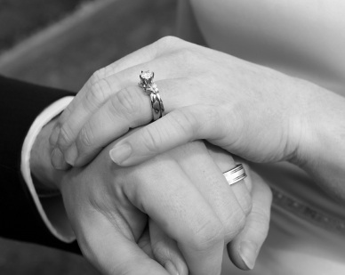
The Sacrament of Matrimony
(Marriage)
Defined as:
A covenant or partnership of life between a man and woman, which is ordered to the well–being of the spouses and to the procreation and upbringing of children. When validly contracted between two baptized people, marriage is a sacrament (Matrimony) (CCC 1601)
Notes:
Defined as:
A covenant or partnership of life between a man and woman, which is ordered to the well–being of the spouses and to the procreation and upbringing of children. When validly contracted between two baptized people, marriage is a sacrament (Matrimony) (1601). (CCC)

Slide 7
The Vocation to Chastity
We are called to live a chaste life
CCC 2337: Chastity means the successful integration of sexuality within the person and thus the inner unity of man in his bodily and spiritual being. Sexuality, in which man's belonging to the bodily and biological world is expressed, becomes personal and truly human when it is integrated into the relationship of one person to another, in the complete and lifelong mutual gift of a man and a woman. The virtue of chastity therefore involves the integrity of the person and the integrality of the gift.
CCC 2345: Chastity is a moral virtue. It is a gift from God, a grace, a fruit of spiritual effort. The Holy Spirit enables one whom the water of Baptism has regenerated to imitate the purity of Christ.

Slide 8
The Ordination of Deacons – “In Order to Serve”
CCC 1569: At the lower level of the hierarchy are to be found deacons, who receive the Imposition of Hands ‘not unto de priesthood, but unto the ministry’. At the ordination to the diaconate ONLY the bishop lays hands on the candidate, thus signifying the deacon’s special attachment to the bishop in the tasks of his ‘diakonia’”.
CCC1570 Deacons share in Christ’s mission and grace in a special way. The sacrament of Holy Orders marks them with an imprint (“character”) which cannot be removed, and which configures them to Christ, who made himself the “deacon” or servant of all.

Slide 9
The Order of Deacons
Among other tasks, it is the task of deacons to
1. Assist the bishop and priests in the celebration of the divine mysteries, above all the Eucharist, in the distribution of Holy Communion
2. Assisting at and blessing marriages
3. In the proclamation of the Gospel and preaching
4. In presiding over funerals
5. In dedicating themselves to the various ministries of charity

Slide 10
The Order of Deacons
CCC 1571: Since the Second Vatican Council the Latin Church has restored the diaconate “as a proper and permanent rank of the hierarchy” (Lumen Gentium, 29.2)…This permanent diaconate, which can be conferred on married men, constitutes an important enrichment for the Church's mission.
Indeed, it is appropriate and useful that men who carry out a truly diaconal ministry in the Church, whether in its liturgical and pastoral life or whether in its social and charitable works, should “be strengthened by the imposition of hands which has come down from the apostles. They would be more closely bound to the altar and their ministry would be made more fruitful through the sacramental grace of the diaconate.” (Ad Gentes, 16.6)

Slide 11
Marriage and Family
“In particular the deacon and his wife must be a living example of fidelity and indissolubility in Christian marriage before a world which is in dire need of such signs.
By facing in a spirit of faith the challenges of married life and the demands of daily living, they strengthen the family life not only of the Church community but of the whole of society.
They also show how the obligations of family life, work and ministry can be harmonized in the service of the Church’s mission.
Deacons and their wives and children can be a great encouragement to others who are working to promote family life.” (National Directory, 73)

Slide 12
The Married Deacon
The majority of deacons in the United States are married. These men bring to the Sacrament of Holy Orders the gifts already received and still being nurtured through their participation in the Sacrament of Matrimony.
This sacrament sanctifies the love of husbands and wives, making that love an efficacious sign of the love of Christ for his Church.
Marriage requires an “interpersonal giving of self, a mutual fidelity, a source of [and openness to] new life, [and] a support in times of joy and sorrow.”
Lived in faith, this ministry within the domestic Church is a sign to the entire Church of the love of Christ.
It forms the basis of the married deacon’s unique gift within the Church. (National Directory, 72)

Slide 13
The Married Deacon
A married deacon, with his wife and family, gives witness to the sanctity of marriage. The more they grow in mutual love, conforming their lives to the Church’s teaching on marriage and sexuality, the more they give to the Christian community a model of Christ-like love, compassion, and self-sacrifice.
The married deacon must always remember that through his sacramental participation in both vocational sacraments, first in Matrimony and again in Holy Orders, he is challenged to be faithful to both. With integrity he must live out both sacraments in harmony and balance. (National Directory, 74)

Slide 14
Family – Forming a Community of Persons
The love between husband and wife and, in a derivatory and broader way, the love between members of the same family-between parents and children, brothers and sisters and relatives and members of the household-is given life and sustenance by an unceasing inner dynamism leading the family to ever deeper and more intense communion, which is the foundation and soul of the community of marriage and the family. (Familiaris Consortio – Christian Family in the Modern World – St. Pope John Paul II)
The Married Deacon is the role model for family

Slide 15
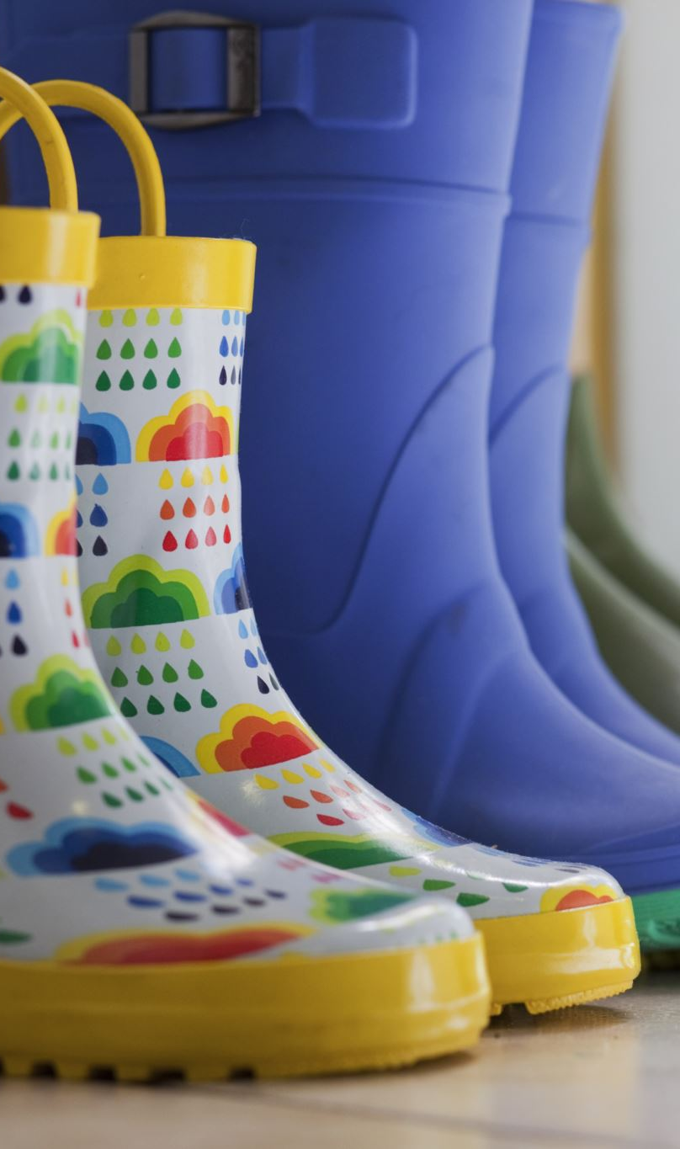
Marriage and Family
Learn to say “No” at times. One may have to reschedule things because of family events.
Set time aside for couple’s time. A wife is an equal partner in the Sacrament of Matrimony. Keep her informed!
For those who exercise a civil profession, one must provide for his own needs and for those of his family with the proceeds of that profession.

Slide 16

Challenges and Opportunities
Be prepared to teach, facilitate and delegate
Learn that not all ministries are in your giftedness
Make time daily to reading and meditating on the Word of God
Frequent, if possible daily, active participation in the Sacrifice of the Mass, receive the Most Holy Eucharist and devoutly visit the Blessed Sacrament
Frequent the Sacrament of Penance
Venerate and love the Virgin Mary, the Mother of God, with fervent devotion
Make time for spiritual retreats, preferably annually

Slide 17
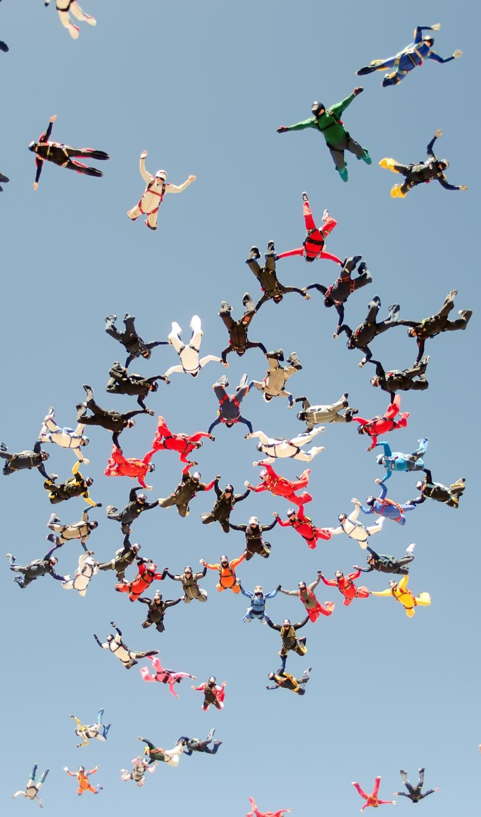
Challenges and Opportunities
Take time off at times for yourself…enjoy a hobby, keep physically active, take care of your health…don’t get burned out!
Learn to collaborate especially with the pastor and staff
Don’t get caught in political situations
Remember…confidentially in ministry
Have a spiritual director
Be positive about life, about change… “I am blessed”
Be a person of prayer and reflection daily

Slide 18

What can you do as you enter formation?
Set priorities and focus on them
Get organized
Learn to manage better your time
Be flexible
Establish support networks and share the load
Let things go (Don’t sweat the small stuff)
Simplify your life…practice gratitude!
Remember…It’s more important to “BE” than “DO”

Slide 19

Is my life in balance?
Quintessential Careers – Deacon Frank Ashley, Ed. D
Directions: Answer true or false to each statement below.
I find myself spending more and more time on church-related projects.
I often feel I don’t have time for myself… or for my family and friends.
No matter what I do, it seems that often every minute of every day is always scheduled for something.
Sometimes I feel as though I’ve lost sight of who I am and why I entered the diaconate.
I can’t remember the last time I was able to find time to take a day off to do something fun… something just for me.
I feel stressed out most of the time.
I can’t even remember the last time I used all my allotted vacation and personal days.

Slide 20
Is my life in balance?
Quintessential Careers – Deacon Frank Ashley, Ed. D
It sometimes feels as though I never even have a chance to catch my breath before I have to move on to the next project/crisis.
I can’t remember the last time I read… and finished… a book that I was reading purely for pleasure.
I wish I had more time for some outside interests and hobbies, but I simply don’t.
I often feel exhausted… even early in the week.
I can't remember the last time I went to the movies or visited a museum or attended some other cultural event.
I do what I do because so many people (children, partners, parents, priests, deacons, parishioners,) depend on me for support.
I’ve missed many of my family’s important events because of church-related time pressures and responsibilities.
I almost always bring work home with me.

Slide 21

Scoring
Give yourself 1 point for each “true” response
*Note that each “true” response is a sign that you probably need to make changes in your life.
*And the higher the number, the more critical it is for you to make changes in your lifestyles.
If you scored …
0-2 Your life is in pretty good balance; just be sure to do what you can to guard that balance.
3-5 Your balance is teetering on the edge; now is the time to make changes before the problems overwhelm you.
5+ Your life is out of balance; you need to take immediate action to make changes in your life before things start crashing around you.

