Slide 1
Diaconal Ministry
“He saved us and called us to a holy life, not according to our works but according to his own design and the grace bestowed on us in Christ Jesus before time began. (2 Timothy 1:9)
Notes:
We are all called to a holy life. But it is not about you. It is about a calling and the grace bestowed on us before time began.

Slide 2
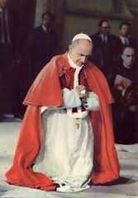
Diaconal Ministry
The diaconate was restored as a permanent ministry by Pope Paul VI, on June 18, 1967, upon the recommendation of the Fathers of the Second Vatican Council.

Slide 3
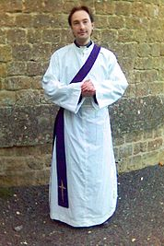
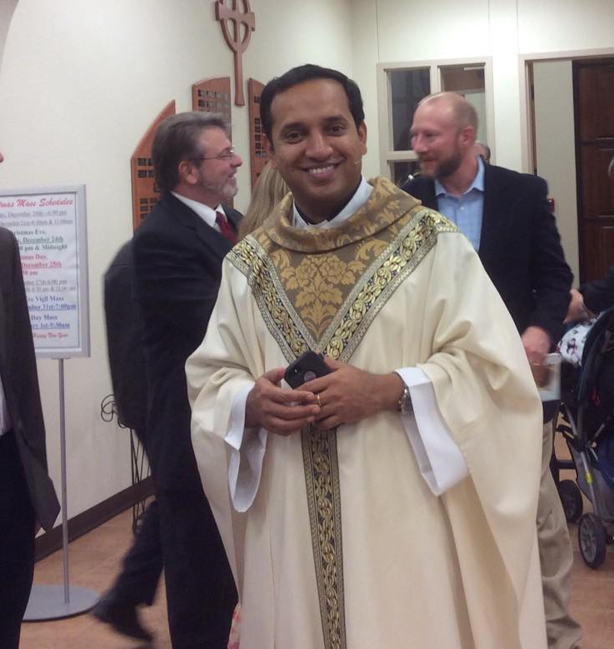
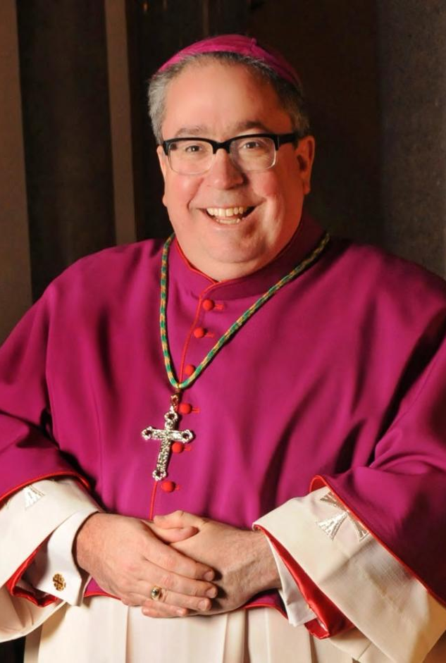
Diaconal Ministry
The diaconate is one of the three levels of the Sacrament of Holy Orders.
deacon Priest Bishop

Slide 4
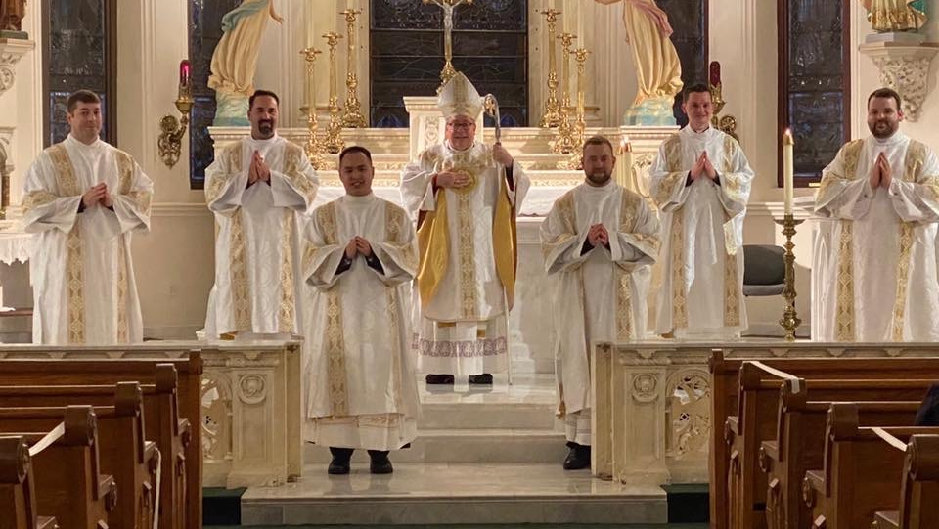
Diaconal Ministry
The "permanent” deacon is not longer a lay person, but a member of the clergy (a sacred minister)
(Directory For Ministry and Life of Permanent Deacons, 1).

Slide 5
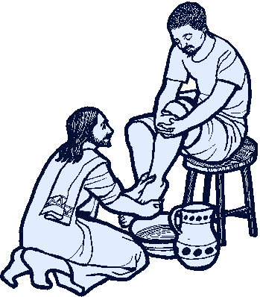
Diaconal Ministry
The deacon is “configured” to
“Christ the Servant”
Jesus taught with authority, and he gave an example of leadership which involved service rather than power.

Slide 6
Diaconal Ministry
The sign of this sacrament of service is the laying on of hands by the Bishop.

Slide 7
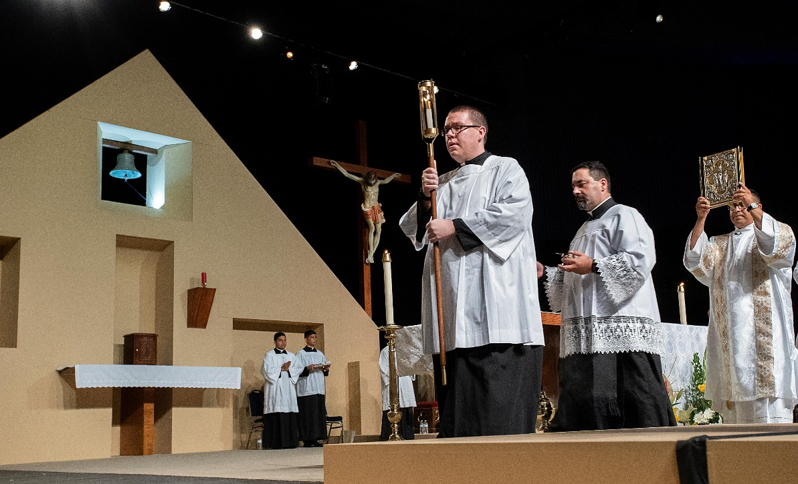
Diaconal Ministry
“Receive the Gospel of Christ, whose herald you have become. Believe what you read, teach what you believe, and practice what you teach.”
Notes:
When a Deacon is present at the Liturgy of the Mass, he is the one who proclaims the Gospel.

Slide 8
Diaconal Ministry
The service ministry of a deacon may take many forms.
Most deacons serve in parish ministry, primarily working with the pastor and parish staff.
The deacon should call others to ministry by his witness and his example.
Notes:
As enthused as one may be, you can’t do everything yourself. A Deacon is called to work among those in your parish and community.

Slide 9
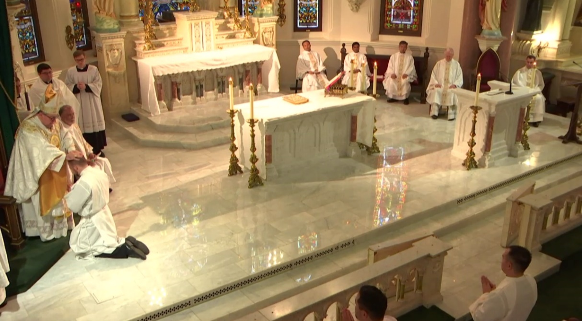
Diaconal Ministry
Deacons are NOT “mini” priests.
A vibrant diaconate will enhance and expand the vocation and ministry of the priesthood
Notes:
As deacons, we are called to promote the answer to the call to the priesthood. The vocations are out there and we must do our part to assist in the discernment of those men who may have questions to their priestly calling.

Slide 10
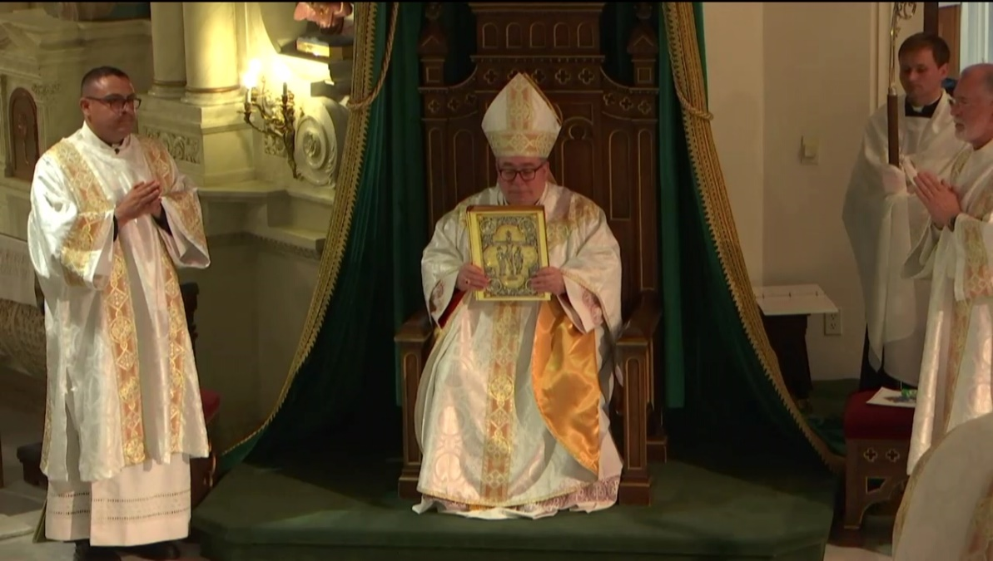
Diaconal Ministry
The deacon participates in the threefold “diakonia” (ministry of service) of Jesus Christ
Liturgy
Word
Charity
Notes:
Munera – service or action for the benefit of the people

Slide 11

Ministry of the liturgy
Diaconal Tasks
  Administer Baptism solemnly
  Reserve and distribute the Eucharist
  Assist at and bless Marriages in the name of the Church
  Take Viaticum to the dying
  Preside over the worship and the prayer of the faithful
  Administer sacramentals
  Officiate at funerals and burial services
Notes:
Of course, Deacons do not hear confessions, but in working with the faithful, you will hear some confessions, whether you like it or not. You just can’t give absolution.
SACRAMENTALS: Roman Catholic Church. an action, as the sign of the cross, a ceremony resembling a sacrament, or a sacred object, regarded as being instituted by the church rather than by Christ and serving as a means of receiving sanctifying grace. Could Deacons be considered Sacramentals?

Slide 12

Ministry of the word
Diaconal Tasks
  Proclaims the Gospel to the faithful
  Instructs and exhorts the people
  Sanctifies through the Sacraments
  Helps lead the community in its religious life
Notes:
Because you are visible in your liturgical ministry, you will be “watched” anywhere and everywhere you go. As all Christians, we are not called to “practice our faith”, we are called to live it.
And so as Deacon, it is not what you “do”; it becomes who you are…in all things.

Slide 13

Ministry of charity
  Diaconal Tasks
  Feed the hungry
  Give drink to the thirsty
  Visit the imprisoned
  Bury the dead
  Clothe the Naked
  Visit the sick and homebound
  Assist the marginalized and the less fortunate
  Shelter the homeless
Notes:
We are called to this: Matthew 25: 34-40 THE JUDGMENT OF THE NATIONS
“Whatever you did for one these least brothers of mine, you did for me.”
CCC1829: The fruits of Charity are joy, peace, and mercy; charity demands beneficence and fraternal correction; it is benevolence; it fosters reciprocity and remains disinterested and generous; it is friendship and communion: “Love is itself the fulfillment of all our works. There is the goal; that is why we run: we run toward it, and once we reach it, in it we shall find rest.”
When Blessed Mother Teresa was asked why she did what she did in caring for the those in Calcutta she said, referring to this passage from Matthew’s Gospel, she said, “You Did It For Me.”

Slide 14
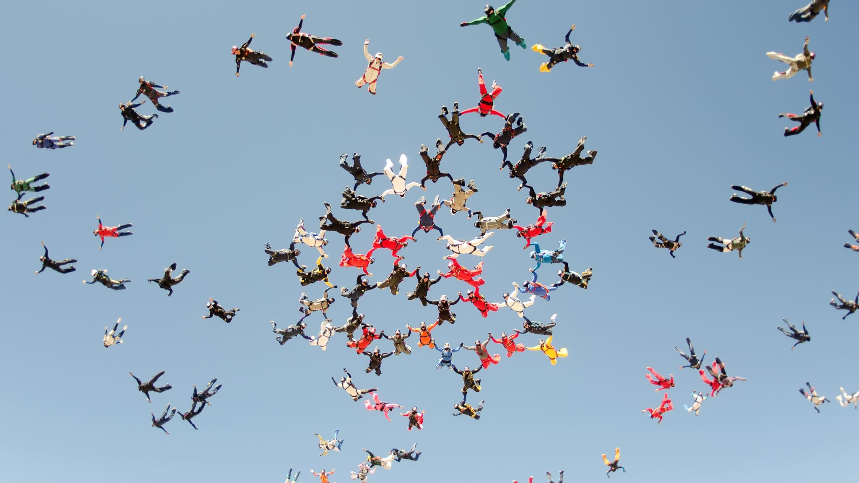
Diaconal Ministry
Assistance to society comes in many forms and sometimes that will mean for you to just “be there.” Many times the presence of the ordained clergy brings peace at times of loss and trouble.

Slide 15
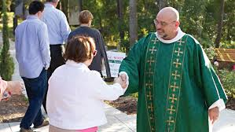
Diaconal Ministry
The role of the deacon does not detract from the vital role of an endowed lay faithful. In fact, it should enrich it.

Slide 16
Diaconal Ministry
PRAY
“Speak to your servant and permit me to hear you.
Tell me what you desire and let me find it agreeable.
Give me the burden you judge to be fitting and assist me to bear it.
Use me for whatever purpose you choose and help me not be found wanting.
Command me to act in accord with your will and grant the grace to do so.
Let me be nothing that You may be everything.”
Notes:
So…how can we possibly listen to be open to this vocational calling? PRAYER; prayer is so important…in all things.
One of the prayers that my wife and I pray each morning is this one.

Slide 17
Diaconal Ministry
“As the Father has sent me, so I send you.”
(John 20:21)
Always remember this:
“It was not you who chose me, but I who chose you and appointed you to go and bear fruit that will remain…” (John 15:16)
Notes:
Each one of us has been sent. How will each of us respond?
(Luke 6:44) “For every tree is known by its fruit.’ So…”go and bear fruit that will remain.”

