Slide 1
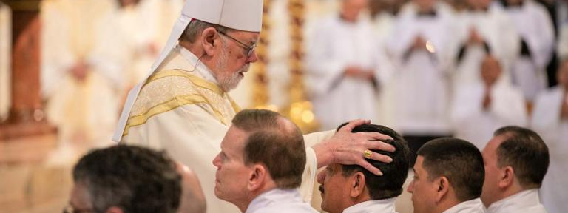
THE SPIRITUALITY OF A DEACON
Sacramental Character: configuration to Christ the Servant of all

Slide 2
Life of holiness
“Never preach without prayer”
“Be a man of prayer…it is not enough to know about Christ but you must know Christ…”

Slide 3
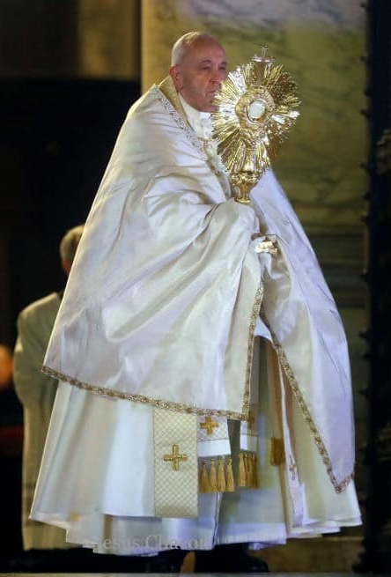
Pope Francis, On the call to holiness, 147
Holiness consists in a habitual openness to the transcendent, expressed in prayer and adoration. The saints are distinguished by a spirit of prayer and a need for communion with God. They find an exclusive concern with this world to be narrow and stifling, and, amid their own concerns and commitments, they long for God, losing themselves in praise and contemplation of the Lord. I do not believe in holiness without prayer…

Slide 4
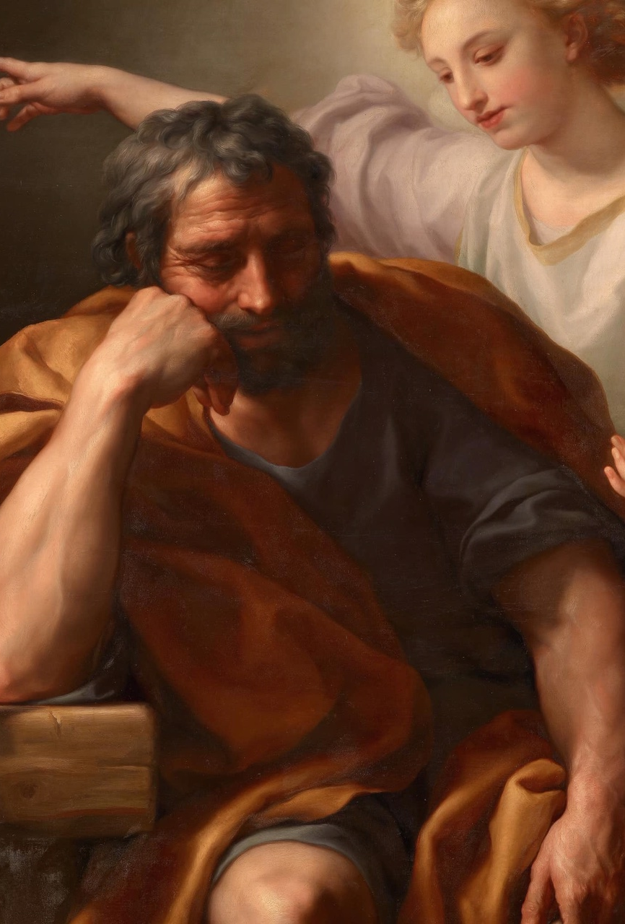
Pope Francis, on the call to holiness, 162
For this spiritual combat, we can count on the powerful weapons that the Lord has given us: faith-filled prayer, meditation on the Word of God, the celebration of Mass, Eucharistic adoration, sacramental reconciliation, works of charity, community life, missionary outreach.
St. Joseph, pray for us…

Slide 5

Formation documents
BASIC NORMS FOR THE FORMATION
OF PERMANENT DEACONS
DIRECTORY FOR THE MINISTRY AND LIFE
OF PERMANENT DEACONS

Slide 6
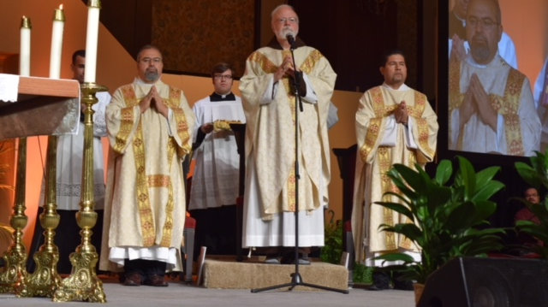
Diaconate after the 5th century
Up to the fifth century the Diaconate flourished in the western Church, but after this period, it experienced, for various reasons, a slow decline which ended in its surviving only as an intermediate stage for candidates preparing for priestly ordination.

Slide 7
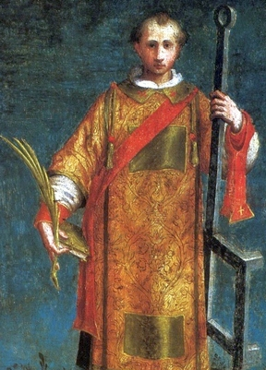
Acts of the apostles 6:1-6
(Acts 6:3-8)Therefore, brethren, select out from among you seven men of good repute, full of the Spirit and of wisdom, whom we may appoint to this duty. But we will devote ourselves to prayer and to the ministry of the word." And what they said pleased the whole multitude, and they chose Stephen, a man full of faith and of the Holy Spirit,… And Stephen, full of grace and power, did great signs and wonders among the people.

Slide 8
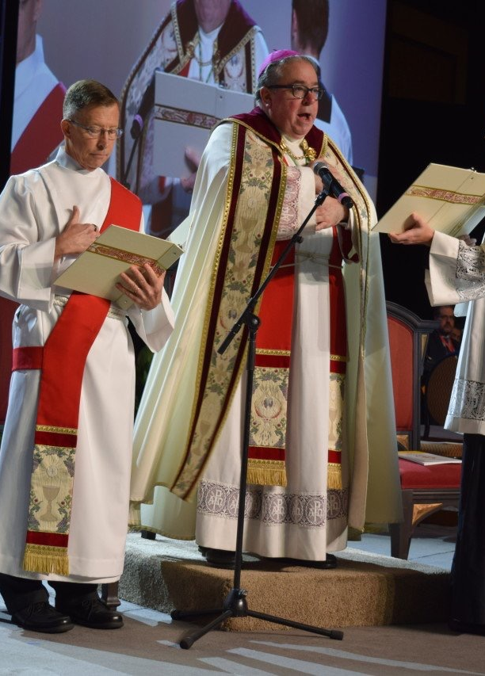
Signs and wonders
Mark 16:20 And they went out and preached everywhere, while the Lord worked with them, and confirmed the word by the signs that followed.
Acts 2:43 Everyone kept feeling a sense of awe; and many wonders and signs were taking place through the apostles.
Acts 5:12 At the hands of the apostles many signs and wonders were taking place among the people; and they were all with one accord in Solomon's portico.

Slide 9
Signs and wonders
Acts 15:12 All the people kept silent, and they were listening to Barnabas and Paul as they were relating what signs and wonders God had done through them among the Gentiles.
Acts 14:3 Therefore they spent a long time there speaking boldly with reliance upon the Lord, who was testifying to the word of His grace, granting that signs and wonders be done by their hands.
Hebrews 2:4 God also testifying with them, both by signs and wonders and by various miracles and by gifts of the Holy Spirit according to His own will.

Slide 10
The national director for the formation, of permanent deacons in the usa
Articulate his sense of call a total of 23 times:
To articulate his sense of a call to the diaconate primarily because of the needs of the Church, as well as for personal growth; and to articulate reasons that support his desire to be a deacon.
To articulate his relationship with God and reasons for believing he has a call to the Order of Deacons within the formation community.
To articulate his call and commitment to his spiritual director and to the formation personnel and to communicate this through self/peer/formation/pastoral/family assessments.
To articulate the ways in which Scripture illumines and promotes his personal growth in
faith and that of others
An understanding and appreciation of the diaconal vocation, with an ability to articulate this call through the primary ministries of word, liturgy, and charity.

Slide 11
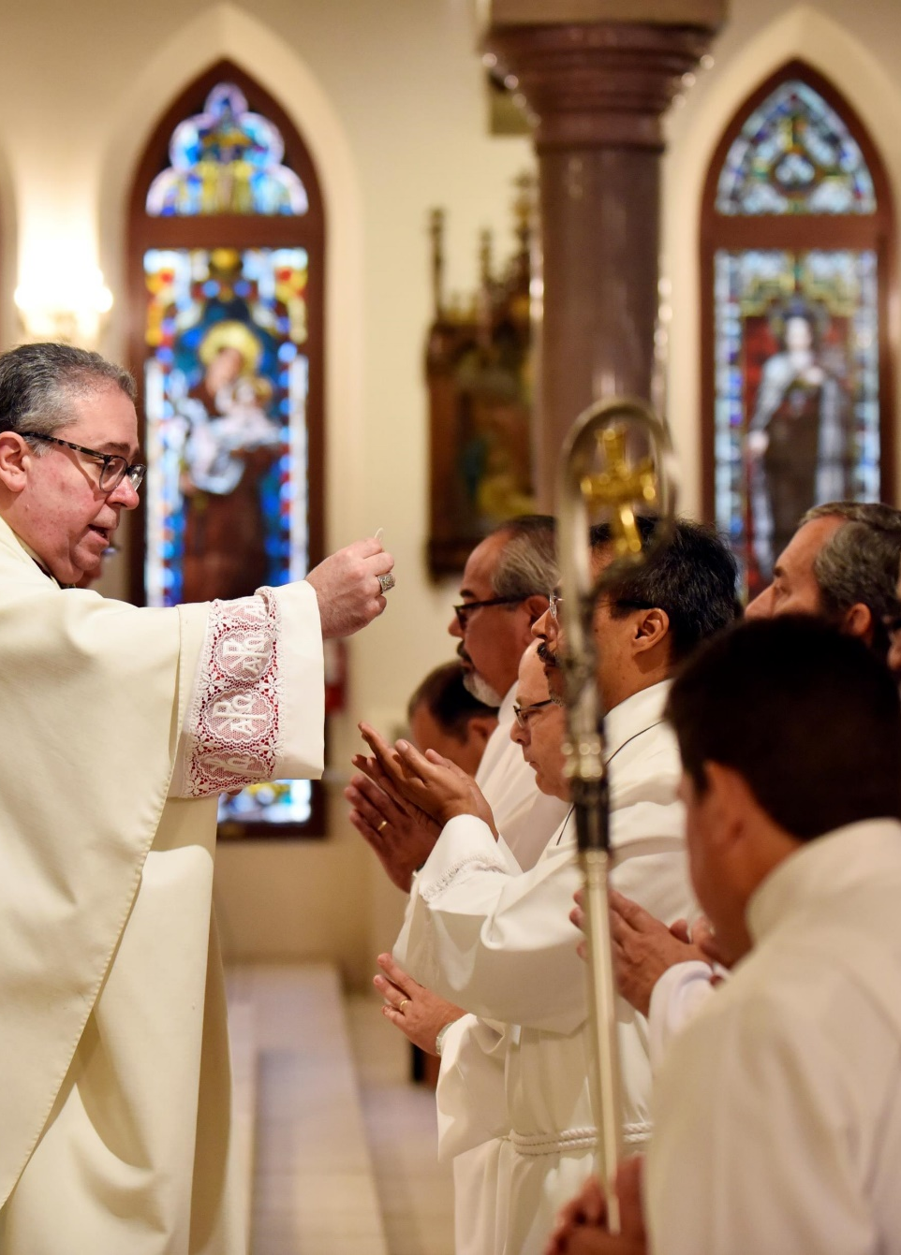
Rite of Candidacy
“But the call of the Lord must be heard and understood by means of signs which reveal daily to the wise the will of God.”
“Those whom God chooses to be sharers in the ministerial Servanthood of Christ, he prompts and helps with grace.”
“Compelled by the love of Christ and strengthened by the inner workings of the Holy Spirit, you have arrived at the moment when you are to express openly your desire to be bound by Holy Orders for the service of God and mankind.”

Slide 12
St. Paul VI, Sacrum diaconatus ordinem (1968)
“Let the deacons, as those who serve the mysteries of Christ and of the Church, abstain from all vice and endeavor to be always pleasing to God, “ready for every good work” for the salvation of men.
By reason, therefore, of the order received they must surpass by far all the others in the practice of liturgical life, in the love for prayer, in the divine service, in obedience, in charity, in chastity.” (25)

Slide 13
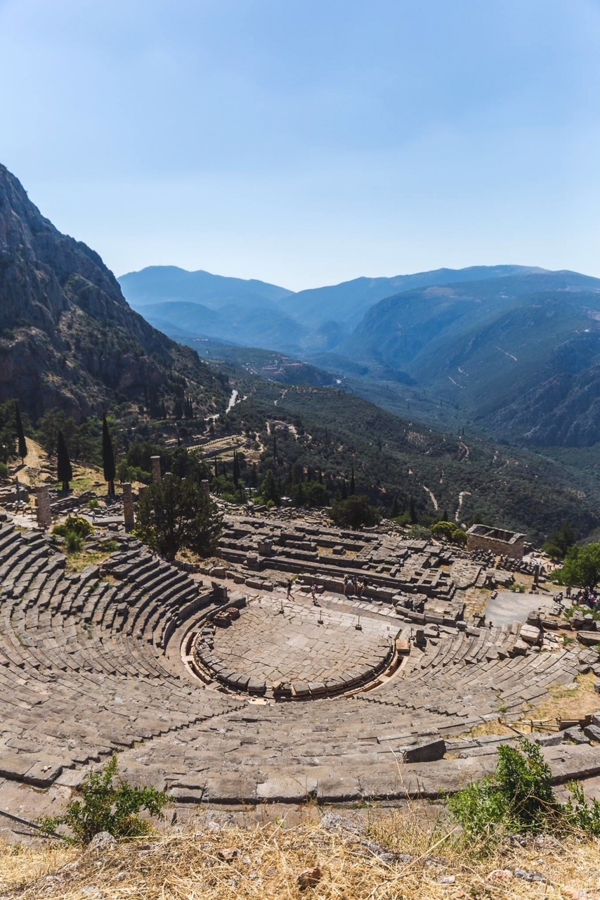
1 Corinthians 9:24-27
Do you not know that the runners in the stadium all run in the race, but only one wins the prize? Run so as to win.
Every athlete exercises discipline in every way. They do it to win a perishable crown, but we an imperishable one.
Thus I do not run aimlessly; I do not fight as if I were shadowboxing.
No, I drive my body and train it, for fear that, after having preached to others, I myself should be disqualified.

Slide 14
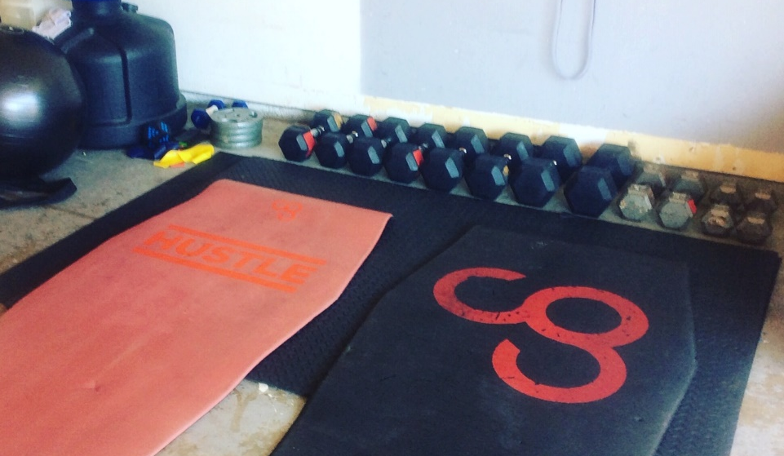
worldy sports
Professional athletes (football players, basketball players, baseball players, etc.)
Areas/steps they have in common:
stretching exercises,
weight training,
sprint training,
endurance training,
mental game,
time executing their particular sport,
coach

Slide 15
7 steps in the spirituality of the deacon
STEP 1
1
DAILY MASS
STEP 2
2
ADORATON/CONTEMPLATON
STEP 3
3
DAILY LECTIO DIVINA
STEP 4
4
DAILY LITURGY OF HOURS
STEP 5
5
DAILY ROSARY
STEP 6
6
FREQUENT CONFESSION
STEP 7
7
SPIRITUAL DIRECTOR

Slide 16
The objectives of spiritual formation
The objectives of the spiritual dimension in formation are
(a) to deepen his prayer life—personal, familial, communal, and liturgical— with special emphasis upon: participation in Eucharist, daily if possible; daily celebration of the Liturgy of the Hours, especially morning and evening prayer; lectio divina; devotion to the Blessed Virgin Mary and the saints; and regular reception of the Sacrament of Reconciliation
(b) to assist the participant, with the help of his spiritual director and those responsible for formation, to deepen and cultivate a service commitment to God’s word, the Church, and the world.

Slide 17
The objectives of spiritual formation
( c ) to acquaint him with the Catholic spiritual tradition reflected in classic spiritual writings and in the lives of the saints, and with contemporary developments in spirituality – a faith seeking to be expressed and celebrated;
(d) to affirm the Christian witness of matrimonial and celibate spirituality;
( e ) to incarnate his spirituality in the real life and history of the people whom he encounters each day in places where he lives, works, and serves.

Slide 18
Step 1 daily mass
The source of this new capacity to love is the Eucharist, which, not by chance, characterizes the ministry of the deacon. In fact, service of the poor is the logical consequence of service of the altar.
Therefore the candidate will be invited to participate every day, or at least frequently, within the limits of his family and professional commitments, in the celebration of the Eucharist and will be helped to penetrate ever deeper into its mystery.
Within the context of this Eucharistic spirituality, care will be taken to give adequate appreciation to the sacrament of Penance. (BASIC NORMS, 73)

Slide 19
Step 1 Daily mass
With regard to the spiritual life, deacons should devote particular importance to the sacraments of grace whose purpose “is to sanctify men, to build up the Body of Christ, and finally to give worship to God”.
Above all, they should participate with particular faith at the daily celebration of the Eucharistic sacrifice, possibly exercising their own proper liturgical munus…(DIRECTORY, 54)

Slide 20
Step 2 adoration and contemplation
ADORE THE LORD, present in the Sacrament, because in the Blessed Eucharist, source and summit of all evangelization, “the whole spiritual good of the Church is contained”. In the Blessed Eucharist they truly encounter Christ who, for love of man, became an expiatory victim, the food of life eternal and friend of all who suffer. (DIRECTORY, 54)

Slide 21
Step 2 adoration and contemplation
Union with Christ, to be cultivated through prayer, sacramental life and in particular, Eucharistic adoration, is of the greatest importance to your ministry, if it is truly to testify to God's love. ADDRESS OF HIS HOLINESS BENEDICT XVI TO THE PERMANENT DEACONS OF ROME (Saturday, 18 February 2006).
“No one eats that flesh without first adoring it; we should sin were we not to adore it…” “The act of adoration outside Mass prolongs and intensifies all that takes place during the liturgical celebration itself. Indeed, only in adoration can a profound and genuine reception mature.” Benedict XVI’s - SACRAMENTUM CARITATIS

Slide 22
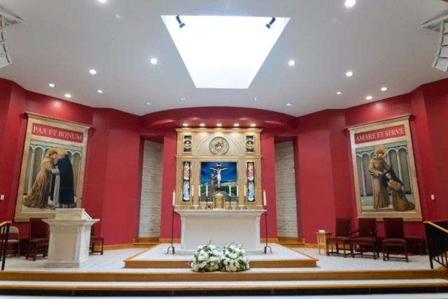
Step 2 adoration and contemplation
“Of all devotions, that of adoring Jesus in the Blessed Sacrament is the greatest after the sacraments, the one dearest to God and the one most helpful to us.” St. John Paul II ENCYCLICAL ECCLESIA DE EUCHARISTIA

Slide 23
Step 2 Adoration and contemplation
Without prolonged moments of adoration, of prayerful encounter with the word, of sincere conversation with the Lord, our work easily becomes meaningless; we lose energy as a result of weariness and difficulties, and our fervor dies out.
The Church urgently needs the deep breath of prayer, and to my great joy groups devoted to prayer and intercession, the prayerful reading of God’s word and the perpetual adoration of the Eucharist are growing at every level of ecclesial life. Pope Francis - EVANGELII GAUDIUM

Slide 24
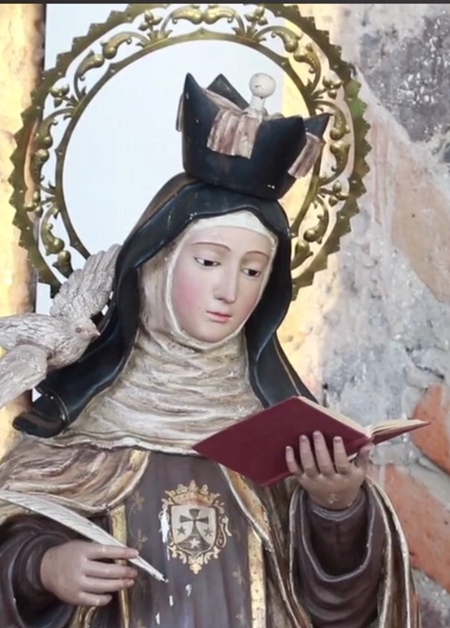
Step 2 adoration and contemplation
56…the lectio divina, arduous mental prayer and the spiritual retreat prescribed by particular law. (DIRECTORY, 56)
Code of Canon Law 276 [Clerics) they are urged to engage in mental prayer regularly…
CCC 2709 What is contemplative prayer? St. Teresa answers: "Contemplative prayer [oracion mental] in my opinion is nothing else than a close sharing between friends; it means taking time frequently to be alone with him who we know loves us." Contemplative prayer seeks him "whom my soul loves."

Slide 25
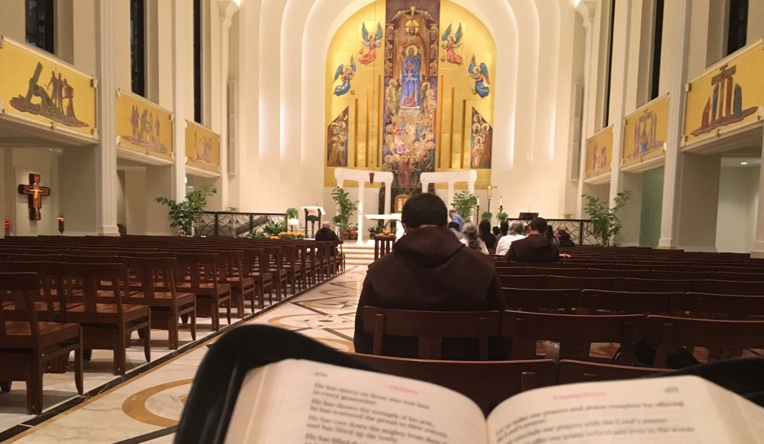
Step 3 prayerful study and prayer with the word of god (lectio divina)
Another characteristic element of diaconal spirituality is the Word of God, of which the deacon is called to be an authoritative preacher, believing what he proclaims, teaching what he believes, living what he teaches. The candidate must therefore learn to know the Word of God ever more deeply and to seek in it constant nourishment for his spiritual life by means of its loving and thorough study and the daily exercise of lectio divina. (BASIC NORMS, 74)

Slide 26
Step 3 lectio divina
The deacon shall always remain faithful to the Lord's command: “But watch at all times, praying that you may have strength to escape all these things that will take place, and to stand before the Son of man” (Lk 21:36 cf. Phil 4:6-7).
Prayer, which is a personal dialogue with God, confers the strength needed to follow Christ and serve the brethren. In the light of this certainty, deacons should form themselves according to the various types of prayer: the celebration of the Liturgy of the Hours…should inform their whole prayer life since deacons, as ministers, intercede for the entire Church. Such prayer is carried over into the lectio divina… (DIRECTORY, 56)

Slide 27
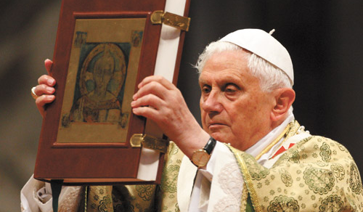
Step 3 lectio divina
For this reason, the privileged place for the prayerful reading of sacred Scripture is the liturgy, and particularly the Eucharist… (Pope Benedict XVI - VERBUM DOMINI)
Dei Verbum: “Let the faithful go gladly to the sacred text itself, whether in the sacred liturgy, which is full of the divine words…”

Slide 28
Step 4 liturgy of the hours
There should also be an introduction to the meaning of the Prayer of the Church. Indeed praying in the name of the Church and for the Church is part of the ministry of the deacon.
This requires a reflection on the uniqueness of Christian prayer and the meaning of the Liturgy of the Hours, but especially a practical initiation into it. To this end, it is important that time be dedicated to this prayer during all meetings of the future deacons. (BASIC NORMS, 75)

Slide 29
Step 4 liturgy of the hours
Deacons have an obligation, established by the Church, to celebrate the Liturgy of the Hours with which the entire Mystical Body is united to the prayer Christ the Head offers to the Father.
Mindful of this obligation, they shall celebrate the Liturgy of the Hours every day according to the approved liturgical books and in the manner determined by the respective Episcopal Conference. (DIRECTORY, 35)

Slide 30
Step 4 liturgy of the hours
Our sanctification is accomplished and worship is offered to God in the liturgy of the hours in such a way that an exchange or dialogue is set up between God and us, in which "God is speaking to his people ... and his people are responding to him by both song and prayer." (General Instruction of the Liturgy of the Hours, 14)

Slide 31

Step 4 liturgy of the hours
Those taking part in the liturgy of the hours have access to holiness of the richest kind through the life-giving word of God, which in this liturgy receives great emphasis. (General Instruction of the Liturgy of the Hours, 14)

Slide 32
Step 5 daily rosary
The element which most characterizes diaconal spirituality is the discovery of and sharing in the love of Christ the servant, who came not to be served but to serve.
The candidate must therefore be helped progressively to acquire those attitudes which are specifically diaconal, though not exclusively so, such as simplicity of heart, total giving of self and disinterest for self, humble and helpful love for the brothers and sisters, especially the poorest, the suffering and the most needy, the choice of a life-style of sharing and poverty.
Let Mary, the handmaid of the Lord, be present on this journey and be invoked as mother and auxiliatrix in the daily recitation of the Rosary. (BASIC NORMS, 72)

Slide 33
Step 5 daily rosary
…Love for Christ and for His Church is profoundly linked to love of the Blessed Virgin Mary, handmaid of the Lord. With her unique title of Mother, she was the selfless helper of her divine Son's diaconia (cf. John 19:25-27). Love of the Mother of God, based on faith and expressed in daily recitation of the Rosary, imitation of her virtues and trust in her, are indeed signs of authentic filial devotion.
With deep veneration and affection Mary looks on every deacon. Indeed, “the creature who more than any other who has lived the full truth of vocation is Mary the Virgin Mother, and she did so in intimate communion with Christ: no one has responded with a love greater than hers to the immense love of God”. (215) This love of the Virgin Mary, handmaid of the Lord, which is born and rooted in the word, will cause deacons to imitate her life. In this way a Marian dimension is introduced into the Church which is very close to the vocation of the deacon. (DIRECTORY, 57)

Slide 34
Step 6 sacrament of penance/confession
. …care will be taken to give adequate appreciation to the sacrament of Penance. (BASIC NORMS, 73)
Conscious of his own weakness and trusting the mercy of God the deacon should regularly approach the Sacrament of Penance, in which sinful man encounters Christ the Redeemer, receives forgiveness of sin and is impelled towards the fullness of charity. DIRECTORY, 54)
Can. 276 (5) to approach the sacrament of penance frequently…
The Code of Canon Law : A text and Commentary by Paulist Press (Burgandy cover) explains
Can. 276 what "to approach the sacrament of penance frequently" means on page 209.
"The 1983 Code properly places the responsibility directly on the clerics. They (clerics) are to approach the sacrament of penance frequently (PO18). The Code does not offer here or elsewhere any further guideline. The Sacred Congregation for Religious and Secular Institutes in the Decree on Confession for Religious on December 8, 1970 did indicate that "frequently" meant "twice a month."

Slide 35
Step 7 spiritual director
The spiritual director is chosen by each aspirant or candidate…His task is that of discerning the workings of the Spirit in the soul of those called and, at the same time, of accompanying and supporting their ongoing conversion; he must also give concrete suggestions to help bring about an authentic diaconal spirituality and offer effective incentives for acquiring the associated virtues.
Because of all this, aspirants and candidates are invited to entrust themselves for spiritual direction only to priests of proven virtue, equipped with a good theological culture, of profound spiritual experience, of marked pedagogical sense, of strong and refined ministerial sensibility. (BASIC NORMS, 23)

