Slide 1
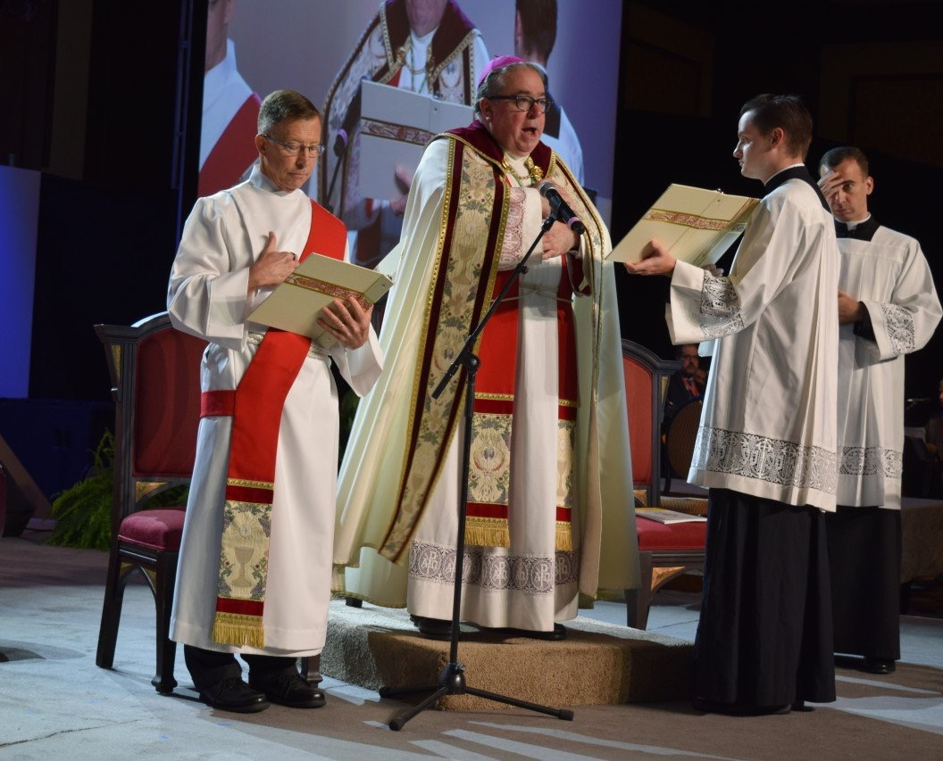
Basic Norms for the Formation of permanent deacons (Basic norms, 4-12)
The Theology of the Diaconate
Notes:
NOTE:
To change the image on this slide, select the picture and delete it. Then click the Pictures icon in the placeholder to insert your own image.

Slide 2
The ecclesiological and Christological perspective (Basic Norms, 4)
The Diaconate must be understood from within the Church which is understood as a mystery of Trinitarian communion in missionary tension
The identity of every ordained minister (communion and mission): A specific [concrete] participation in and representation of the ministry of Christ

Slide 3
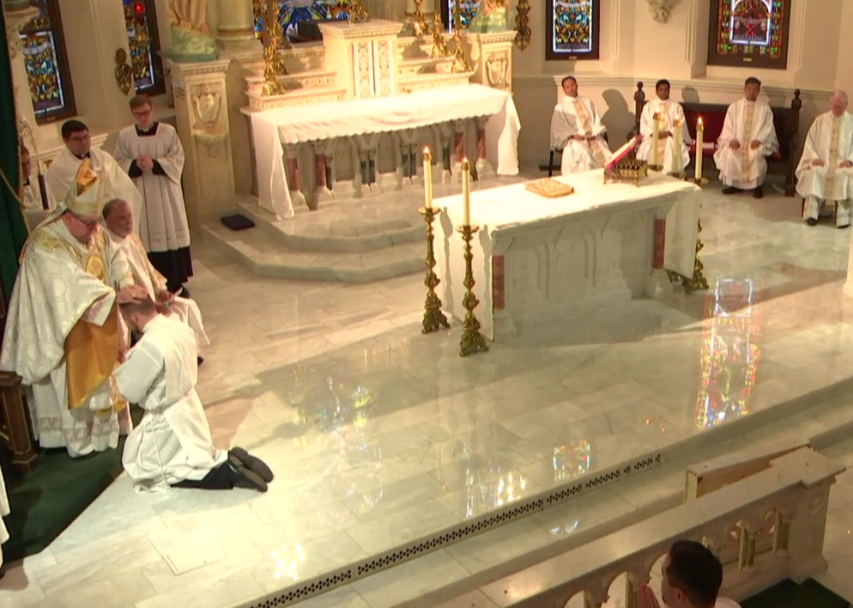
The ecclesiological and Christological perspective
The Deacon receives the “laying on of hands” and is sustained by a specific “sacramental grace” which inserts him into the Sacrament of Orders

Slide 4
Specific Configuration to Christ (Basic Norms, 5)
The Diaconate is conferred through a special outpouring of the Holy Spirit (Ordination)
it brings a specific conformation to Christ (servant of all) on the one who receives it
The laying on of hands on the deacon: “not ad sacerdotium sed at ministerium”
“Not for the celebration of the Eucharist but for service”
The specific theological identity of the deacon: a participation in the one ecclesiastical ministry, he is a specific sacramental sign, in the Church, of Christ the servant

Slide 5
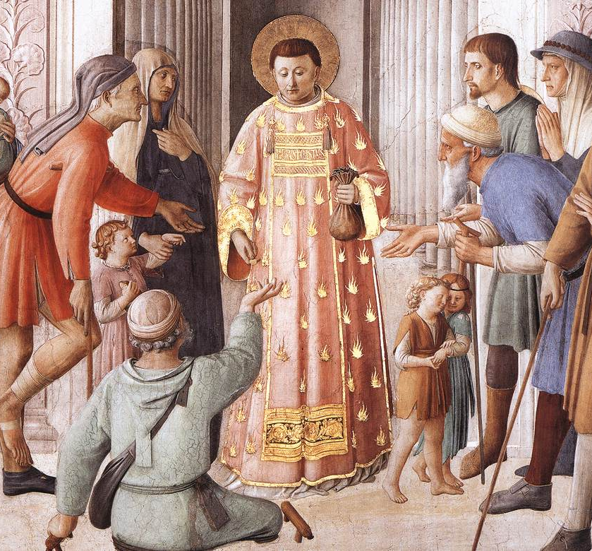
Specific Configuration to Christ
The role of the deacon: is to express the needs and desires of the Christian communities and to be a driving force for service (diakonia) – which is an essential part of the mission of the Church (Basic Norms, 5)
(photo: Fra Angelico’s painting of St. Lawrence distributing alms to the poorhttps://fraangelicoinstitute.com/2012/08/10/the-feast-of-st-lawrence-deacon-and-martyr/)

Slide 6
The Matter and Form of the Sacrament (Basic Norms, 6)
The Matter of diaconal ordination is the laying on of hands of the Bishop
The Form is constituted by the words of the prayer of ordination, which is expressed in the three moments of anamnesis, epiclesis and intercession
Anamnesis: recounts the history of salvation centered in Christ – goes back to the LEVITES, recalling worship, and to the SEVEN of the Acts of the Apostles, recalling charity.

Slide 7
The Anamnesis
“Draw near, we pray, almighty God, Giver of every grace, Who apportion every order and assign every office; Who remain unchanged, But make all things new. In your eternal providence, You make provision of every age, As you order all creation Through him who is your word, Your power, and your wisdom, Jesus Christ, your Son, our Lord.
You grant that the Church, his Body, Adorned with manifold heavenly graces, drawn together in the diversity of its members, And united by a wondrous bond through the Holy Spirit, Should grow and spread forth. To build up a new temple And, as once you chose the sons of Levi To minister in the former tabernacle, So now you establish three ranks of ministers In their sacred offices to serve in your name.
And so, in the first days of your Church, Through the inspiration of the Holy Spirit, Your Son’s Apostles appointed seven men of good repute To assist them in the daily ministry,
That they might devote themselves more fully To prayer and preaching of the word.
By prayer and the laying on of hands They entrusted to these chosen men the ministry of serving at table.”

Slide 8
The Matter and Form of the Sacrament: The Epiclesis
The Epiclesis: invokes the power of the seven gifts of the Holy Spirit so that the ordinand may imitate Christ as “deacon,” that is, “servant” of all
“We beseech you, Lord: Look with favor on these servants of yours, Who will minister at your holy altar, And whom we now humbly dedicate to the Office of Deacon.
Send forth upon them, Lord, we pray, The Holy Spirit, That they may be strengthened
By the gift of your sevenfold grace, For the faithful carrying out Of the work of the ministry.
May there abound in them every Gospel virtue: Unfeigned love, Concern for the sick and poor, Unassuming authority, The purity of innocence, And the observances of spiritual discipline.”

Slide 9
The Matter and Form of the Sacrament: The Intercession
The Intercession: is an exhortation to a generous and chaste life [fruitful ministry and holiness]
“May your commandments shine forth in their conduct, So that by the example of their way of life
They may inspire the imitation of your holy people. In offering the witness of a clear conscience, May they remain strong and steadfast in Christ, So that by imitating on earth your Son, Who came not to be served but to serve, They may be found worthy to reign in heaven with him.
Who lives and reigns with you in the unity of the Holy Spirit, One God for ever and ever.”

Slide 10
The Matter and Form of the Sacrament: The Essential
The Essential Form of the sacrament is the Epiclesis:
“Lord, send forth upon them the Holy Spirit, that they may be strengthened by the gift of your sevenfold grace to carry out faithfully the work of the ministry [service].”
OT references – seven gifts: Isaiah 11:2
  (these are the gifts of the Spirit given to the Messiah)
  the newly ordained receives these gifts

Slide 11
Character and Specific Sacramental Grace (Basic Norms, 7)
The Diaconate, being a degree of holy orders, “imprints” a character and communicates a specific “sacramental grace.”
What is the sacramental character?
  Is the configurative and distinguishing sign “indelibly” impressed on the soul, which configures the one ordained to Christ
What is the sacramental grace?
  It is the strength, vigor [life] specialis, a gift for living the new reality wrought by the sacrament.
Just as in all sacraments which imprint character [baptism, confirmation], grace has a “permanent virtuality.”

Slide 12
Relationship with Bishop and Priests (Basic Norms, 8)
In the exercise of their power, deacons, since they share in a lower grade of ecclesiastical ministry, necessarily depend on the Bishops, who have the fullness of the sacrament of orders.
In addition, deacons are placed in a special relationship with the priests, in communion with whom they are called to serve the People of God.
Christus Dominus, 15:
“Bishops enjoy the fullness of the sacrament of orders and both presbyters and deacons are dependent upon them in the exercise of their authority. For the presbyters are the prudent fellow workers of the episcopal order and are themselves consecrated as true priests of the New Testament, just as deacons are ordained for the ministry and serve the people of God in communion with the bishop and his presbytery. Therefore, bishops are the principal dispensers of the mysteries of God…”

Slide 13
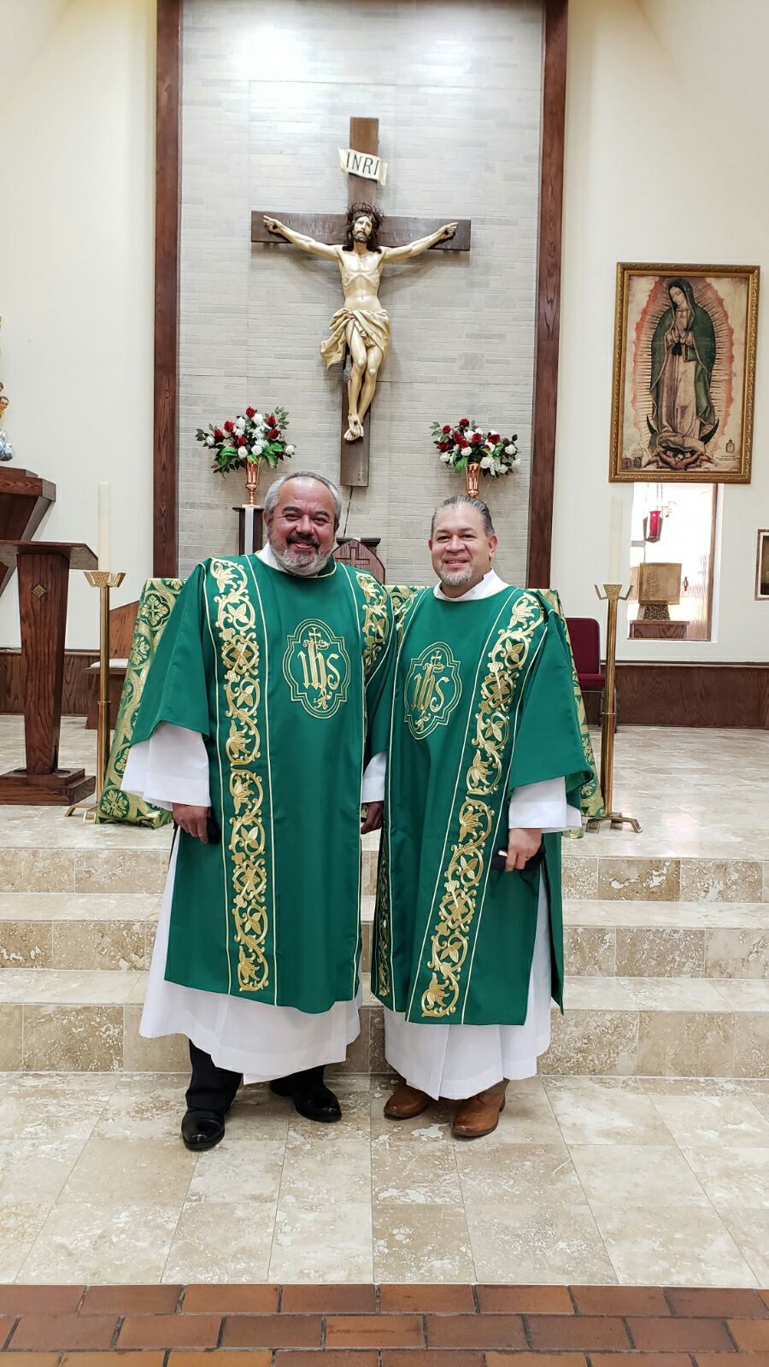
The Ministry of the Deacon in Different Pastoral Contexts (Basic Norms, 9)
The ministry of the deacon is characterized by the exercise of the three “munera” (munus – functions) proper to the Ordained Ministry, according to the specific perspective of diakonia
The munus docendi (ministry of the word)
The Deacon is called to proclaim the Scriptures [Gospel] and instruct [teach] and exhort [strongly encourage] the people

Slide 14
The Ministry of the Deacon in Different Pastoral Contexts (Basic Norms, 9)
The “munus sanctificandi” (ministry of the liturgy) of the deacon is expressed
In prayer,
In the solemn administration of baptism,
In the custody and distribution of the Eucharist,
In assisting at and blessing marriages,
In presiding at the rites of funeral and burial, and
In the administration of sacramentals
Point of departure and arrival in diaconal ministry is the Eucharist
The deacon’s ministry cannot be reduced to simple “social service”

Slide 15
The Ministry of the Deacon in Different Pastoral Contexts (Basic Norms, 9)
The munus regendi (ministry of charity) is exercised in dedication to works of charity and assistance and in the direction of communities or sectors of church life, especially as regards charitable activities.
This is the ministry MOST characteristic of the deacon
The governing (ruling) function of the deacon is being a servant

Slide 16
Diaconal Spirituality (Basic Norms, 11-12)
It is a spirituality of service (flows from his own theological identity)
The Model: Christ the Servant (who recognized himself as the servant of God – Book of Isaiah)

Slide 17
Diaconal Spirituality (Basic Norms, 11-12)
The spirituality of service is a spirituality of the whole church, who is at the service of the salvation of the world
So that the whole Church may better live out this spirituality of service, the Lord gives her a living and personal sign of his very being as servant

Slide 18
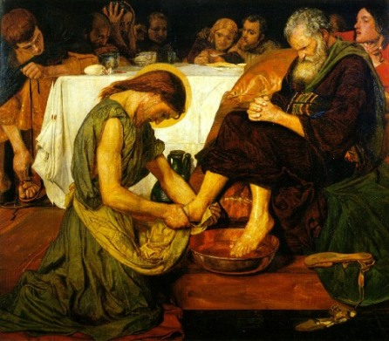
Diaconal Spirituality (Basic Norms, 11-12)
The Deacon, with sacred ordination, is constituted a “living icon” of Christ the servant within the Church
The heart of his spiritual life is service; his sanctification will consist in making himself a generous [available] and faithful servant of God and humanity, especially the poorest and most suffering
The deacon’s ascetic commitment will be directed towards acquiring those virtues necessary for the exercise of his ministry

