Slide 1
Diaconate Formation
Stages of Formation: Initial and Ongoing Formation

Slide 2
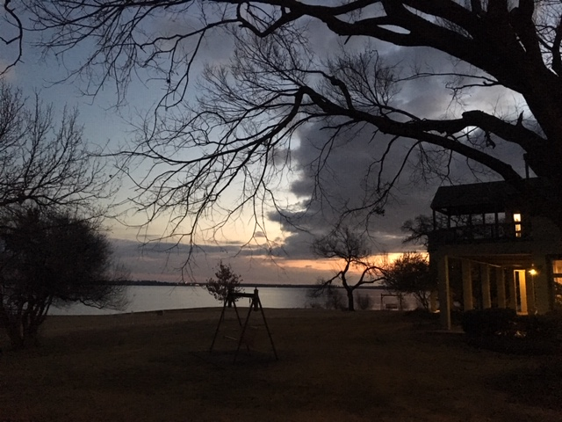
Discernment Stage: Propaedeutic Year (1 year)
Inquiry
  Participation in information session
  Inquirer’s information
Pastor’s Nomination

Slide 3
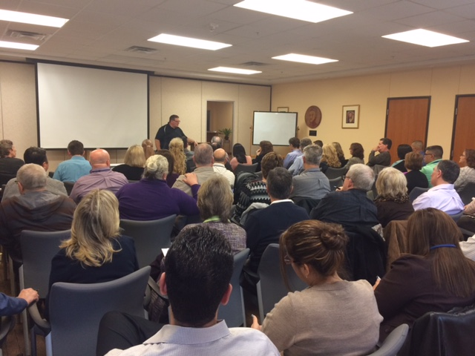
Discernment Stage: Propaedeutic Year (1 year)
PROPAEDEUTIC YEAR
Monthly Discernment Meetings
  Topics: prayer, discernment, Catholic social doctrine, diaconate, Intro to Bible and Basics of the Catechism
Application for admission
  Marital assessment
  Personality Inventory Survey
  Psychological evaluation
Interview with Admissions Committee

Slide 4
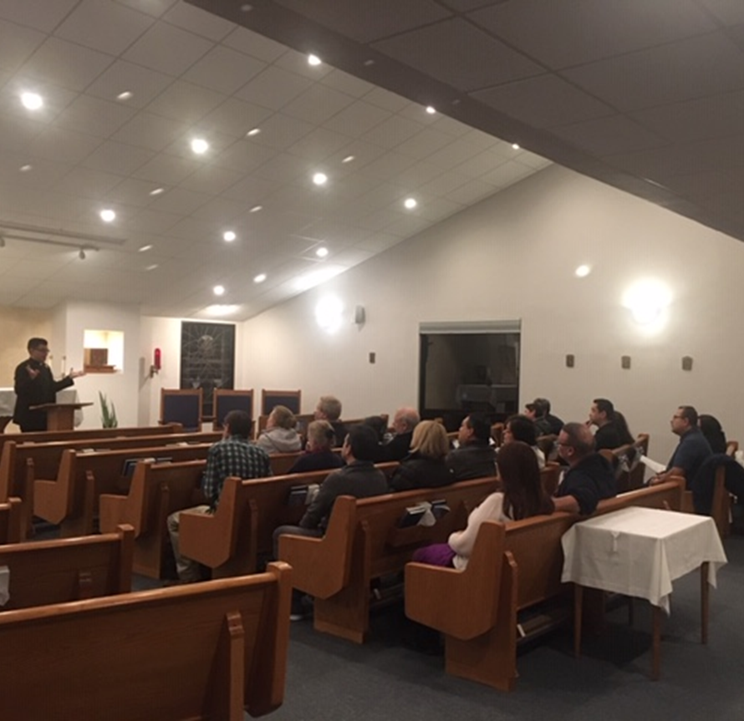
ASPIRANT STAGE (2 YEARS)
Propaedeutic Period = Preparation for candidacy
In-depth study of the diaconate
Introduction to theology and Sacred Scripture
Formation of community

Slide 5
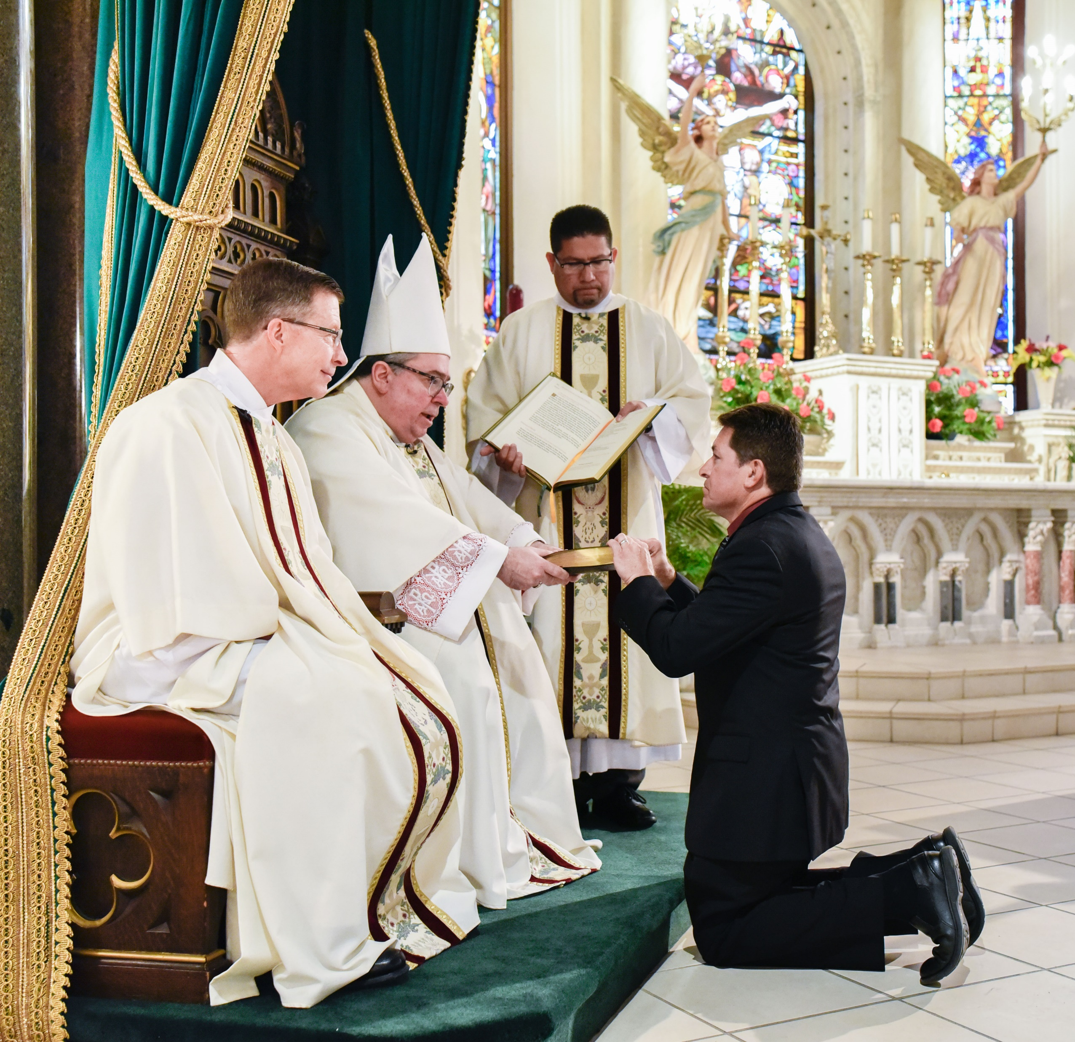
Candidate Stage: Formation for the Diaconate (3 years)
Candidacy for Holy Orders
  Three-year curriculum of theological studies
  Integrated liturgical, pastoral, and spiritual formation
Instituted Ministries
  Lector
  Acolyte

Slide 6
Candidate Stage: Formation for the Diaconate (3 years)
Marriage Enrichment
  Spiritual and human formation for the wives
  Enrichment of the marital bond
Admissions Committee
  Nominates and recommends to the diocesan bishop candidates for promotion to the Order of the Diaconate

Slide 7
Post-Ordination Stage: Ongoing Formation
New deacons
  Mandatory five-year post-ordination formation
Deacons
  Ongoing formation and mentorship according to age and years of ordination and ministry
Wives and family
  Ongoing pastoral formation and care

